Slide 1
Tosca Commander, Qtest and Harness
Parameswari Ettiappan

Slide 2
Goals
UXD Tosca Commander
Modules & Object Identification
Test Case design
Synchronization
Action Modes : Input ,Verify ,WaitOn ,Buffer ,Select ,Constraint
Buffer Operations
Expression evaluator
Process Operations
Window Operations
Reusable Test Step blocks

Slide 3
Goals
Reusable Test Step blocks
Create & Use Libraries
Recovery Scenarios
Working with Execution List
Test Cases linking to execution set
API TestCases
Test Case Design
Accessing Data from Excel

Slide 4
Goals
Manage test data
Tosca Data Integrity Modules
Tosca Continuous Integration
qTest
Harness

Slide 5
Tosca Introduction
Tosca Tricentis refers to a software testing tool developed by the company Tricentis.
Tricentis is a software testing and quality assurance company.
It provides solutions to help organizations automate and optimize their software testing processes.
Tosca is one of their flagship products.

Slide 6
Tosca Introduction
Tosca Tricentis is designed to streamline and accelerate the testing of software applications.
It offers a model-based approach to software testing.
It allows users to create and maintain test cases using graphical models rather than traditional scripting.
This approach aims to make testing more efficient, scalable, and accessible to both technical and non-technical users.

Slide 7
Tosca Introduction
The tool provides a wide range of features, including test case design, test data management, test execution, test reporting, and test automation.
It supports various types of testing, such as functional testing, regression testing, performance testing, and mobile testing.

Slide 8
Tosca
Tosca is an automated testing tool that helps testers design, manage, and execute test cases efficiently.
It leverages a model-based testing approach, which focuses on creating reusable test models instead of scripting.
This makes testing more accessible for business users and technical teams alike.

Slide 9
Key Features of Tosca
Model-Based Testing (MBT):
Tosca uses a model-based approach, meaning tests are built from business process models rather than coding scripts.
This enables high reusability and easy maintenance.
Scriptless Test Automation:
No programming knowledge is needed; testers can create automated test cases through drag-and-drop and configurations.
Wide Technology Support:
Supports testing for web, mobile, API, desktop, and packaged applications like SAP, Salesforce, etc.

Slide 10
Key Features of Tosca
Continuous Testing:
Integrates seamlessly with CI/CD tools like Jenkins, Azure DevOps, and Git for continuous integration and delivery.
Test Data Management:
Tosca offers integrated test data management to handle dynamic test data during automation.
Risk-Based Testing:
Identifies and prioritizes the most critical test cases based on risk, improving test coverage and reducing effort.
API Testing:
Provides capabilities to test APIs independently or as part of an end-to-end test scenario.

Slide 11
Key Features of Tosca
End-to-End Test Automation:
Enables the automation of complete workflows across multiple applications and systems.
User-Friendly Interface:
Offers an intuitive GUI for creating, managing, and analyzing test cases.
AI and Machine Learning:
Implements AI-driven test case optimization and self-healing capabilities to adapt to changes in the application under test.

Slide 12
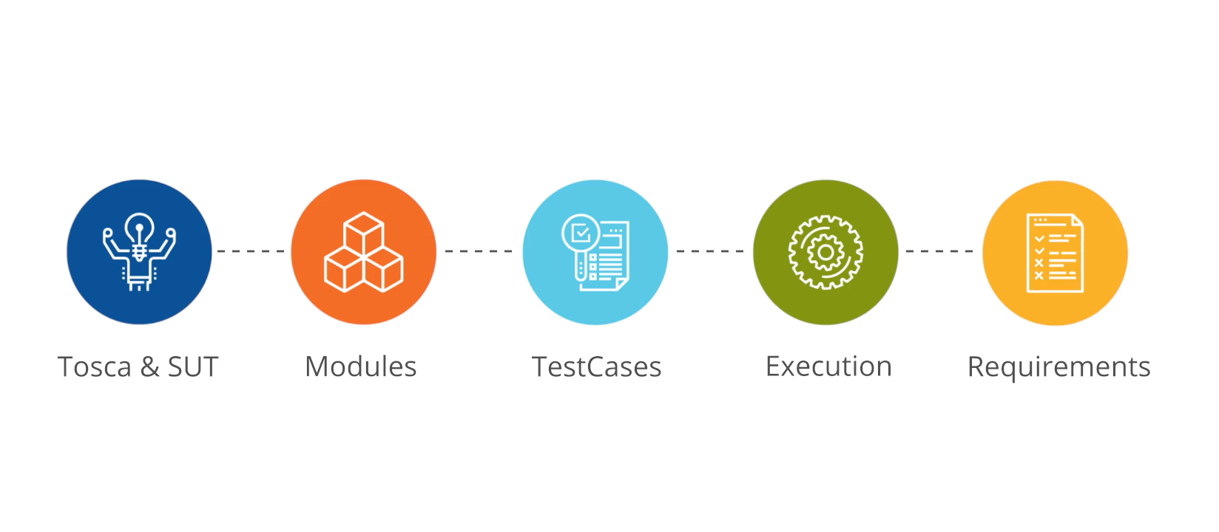
Tosca Introduction

Slide 13
Tosca Introduction
Tricentis Tosca is an enterprise-level test automation tool.
It helps organizations achieve continuous testing, reduce testing efforts, and increase testing efficiency.
Tosca offers various features to support end-to-end testing, including functional testing, regression testing, performance testing, and more.
It is known for its model-based test automation approach.
It allows users to create and manage test cases using graphical representations of the application under test.
This model-based approach simplifies test case creation and maintenance, making it easier for both technical and non-technical users to participate in the testing process.

Slide 14
Tosca Features
Model-Based Test Automation: Users can create test cases by capturing business processes and user interactions visually.
This makes test cases easier to understand and maintain.
Test Data Management: Tosca provides capabilities to manage test data, helping testers to create and maintain data sets for different test scenarios.

Slide 15
Tosca Features
Integrated Test Management: Tosca offers test case management and execution features that allow users to organize, schedule, and execute tests efficiently.
Cross-Browser and Cross-Platform Testing: Tosca supports testing across various browsers and platforms, ensuring application compatibility.

Slide 16
Tosca Features
Continuous Integration and Continuous Testing: Tosca integrates well with CI/CD tools, enabling continuous testing practices.
API Testing: Tosca supports API testing, enabling the testing of application programming interfaces for improved test coverage.
Exploratory Testing: Tosca includes support for exploratory testing, allowing testers to perform ad-hoc and unscripted tests to identify defects and gain insights.

Slide 17
Tosca Features
Tricentis Tosca is used by many enterprises and QA teams to improve their testing processes and ensure the quality of their software applications.
It helps organizations speed up their release cycles, reduce test maintenance efforts, and achieve higher levels of test automation, resulting in more efficient and reliable software testing.

Slide 18
Tosca Features
Tosca is scriptless, AI based, No code automation tool for end-to-end test automation.
Tosca is continuous testing platform that delivers fast feedback for Agile and devops.
It allows us to design functional, automated end to end tests across all layers of enterprise architecture.
It provides real time risk assessment with business focused, actionable results.
It ensures availability of test data at any time.
It can simulate behavior of dependent systems if they are unavailable during test execution.

Slide 19
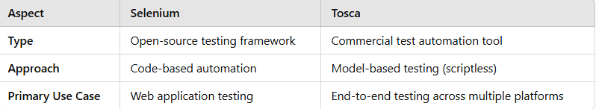
Selenium vs Tosca

Slide 20
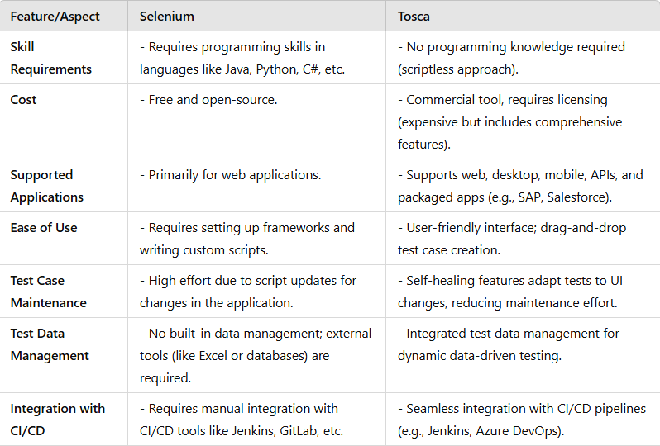
Selenium vs Tosca

Slide 21
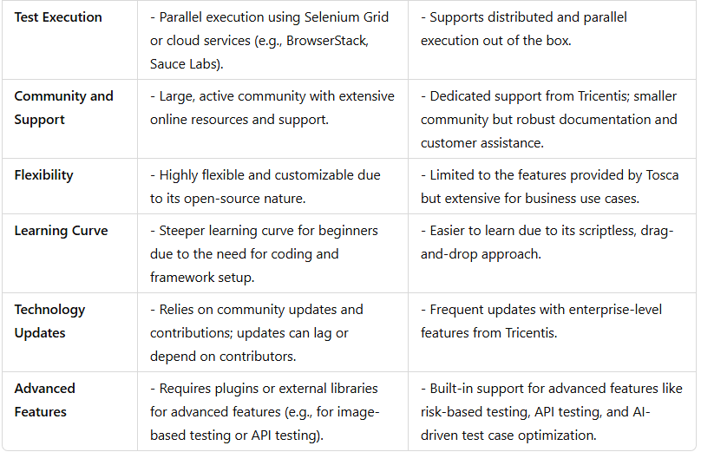
Selenium vs Tosca

Slide 22
When to Choose Selenium?
You have a technical team familiar with programming.
You need a cost-effective solution (open-source).
Your testing is limited to web applications.
You require high customization and control over the testing process.

Slide 23
When to Choose Tosca?
You need a comprehensive testing solution that supports multiple platforms and technologies.
Your team includes non-technical members who prefer a scriptless tool.
You want robust test management, risk-based testing, and easy CI/CD integration.
Budget is not a constraint, and you seek enterprise-grade support.

Slide 24
Tosca Use Cases
Template Validation Test Cases:
Verify that the TOSCA template is well-formed and follows the TOSCA specification.
Ensure that all mandatory fields are present and properly defined.
Check for syntax errors, naming conventions, and data type validations.

Slide 25
Why Use Tosca?
Faster Testing Cycles:
Speeds up testing processes through automation and reusability.
Better Collaboration:
Enables both technical and non-technical teams to work together on testing.
Improved Test Coverage:
Supports a wide range of technologies and risk-based testing to enhance coverage.
Reduced Maintenance:
Self-healing features reduce test case maintenance efforts.

Slide 26
Tosca Use Cases
Node Types and Relationship Test Cases:
Validate that the defined node types match the intended behavior and properties.
Test node inheritance and overriding properties.
Check that relationships between nodes are correctly established and behave as expected.

Slide 27
Tosca Use Cases
Deployment Test Cases:
Deploy the TOSCA template on different cloud environments and ensure successful deployment.
Verify that the application components and services are deployed according to the topology defined in the template.
Check for any errors or issues during the deployment process.

Slide 28
Tosca Use Cases
Scaling Test Cases:
Test scaling scenarios, such as scaling up and down specific components or the entire application.
Verify that the application behaves correctly after scaling operations.

Slide 29
Tosca Use Cases
Scaling Configuration Management Test Cases:
Test the configuration management features to ensure that application configurations are correctly applied.
Check that configuration changes are propagated to the appropriate components. Cases:
Test scaling scenarios, such as scaling up and down specific components or the entire application.
Verify that the application behaves correctly after scaling operations.

Slide 30
Tosca Use Cases
Node Lifecycle Test Cases:
Validate that the node lifecycle events (e.g., create, start, stop, delete) work as expected.
Test the behavior of the application during different lifecycle stages.

Slide 31
Tosca Use Cases
Service Discovery and Load Balancing Test Cases:
Verify that service discovery mechanisms work correctly, allowing components to find and connect to each other.
Test load balancing scenarios to ensure even distribution of traffic across instances.

Slide 32
Tosca Use Cases
Rollback and Recovery Test Cases:
Test rollback scenarios when a deployment or scaling operation fails to ensure that the application returns to its previous state.
Verify recovery mechanisms in case of node failures or system errors.

Slide 33
Tosca Use Cases
Security Test Cases:
Validate that security measures, such as authentication and authorization, are correctly implemented and enforced.
Test access control to sensitive resources and data.

Slide 34
Tosca Use Cases
Cross-Platform Compatibility Test Cases:
Test the portability of the TOSCA templates across different cloud providers and platforms.
Ensure that the application works as expected on various environments.

Slide 35
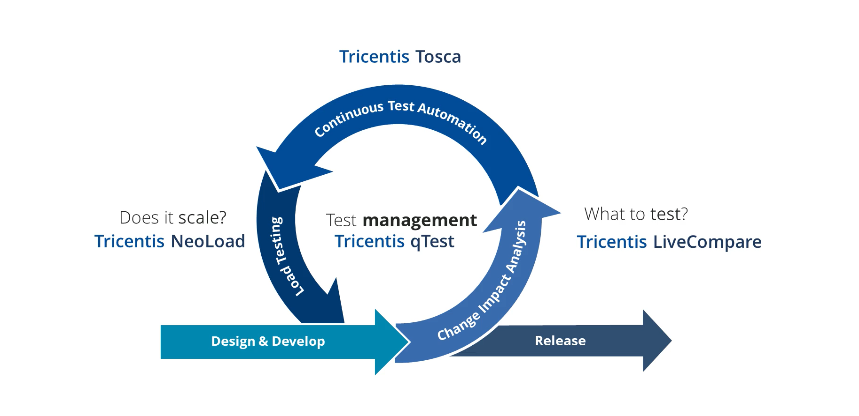
Tosca Continuous Testing

Slide 36
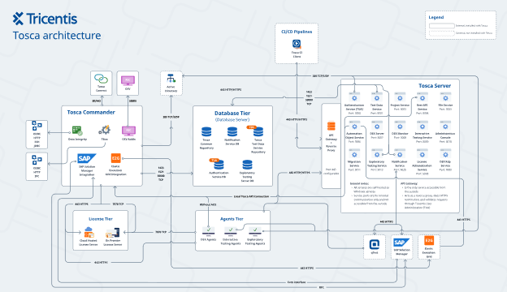
Tricentis Tosca Architecture

Slide 37
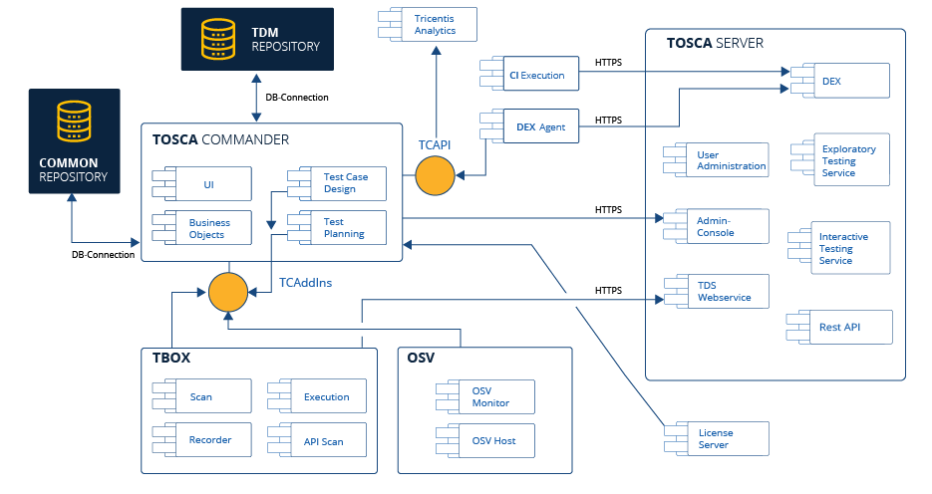
Tricentis Tosca Architecture

Slide 38
Tricentis Tosca Architecture
Component-Based Architecture: Tricentis Tosca follows a component-based architecture, where different functional components interact with each other to perform various testing activities.
These components include the Tosca Commander, Tosca Executor, Tosca Engines, and Tosca Database.

Slide 39
Tricentis Tosca Architecture
Tosca Commander: Tosca Commander is the central component of the architecture.
It provides a graphical user interface (GUI) that allows users to create, manage, and execute test cases.
It also offers features for test planning, test case design, and reporting.

Slide 40
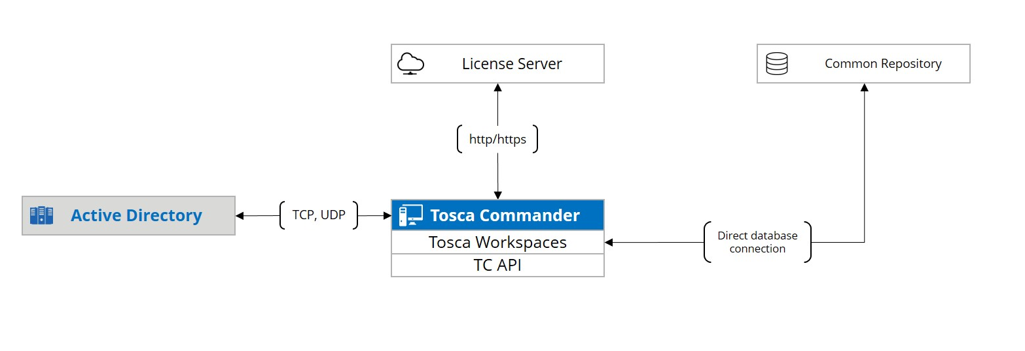
Tricentis Tosca Architecture

Slide 41
Tricentis Tosca Architecture
Tosca Executor: The Tosca Executor is responsible for executing the test cases and interacting with the application under test (AUT).
It utilizes various technologies and protocols to interface with the AUT, such as web browsers, APIs, databases, and more.

Slide 42
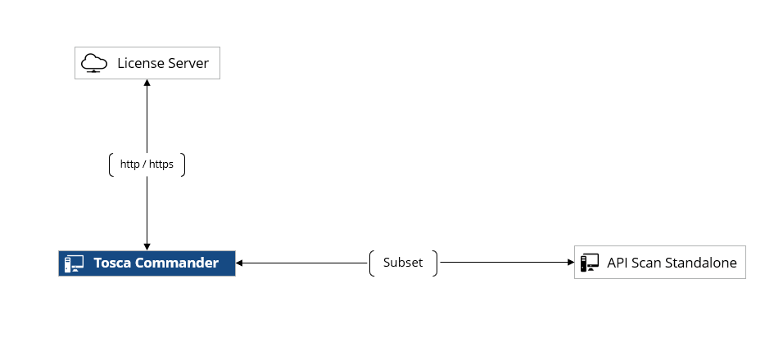
Tricentis Tosca Architecture

Slide 43
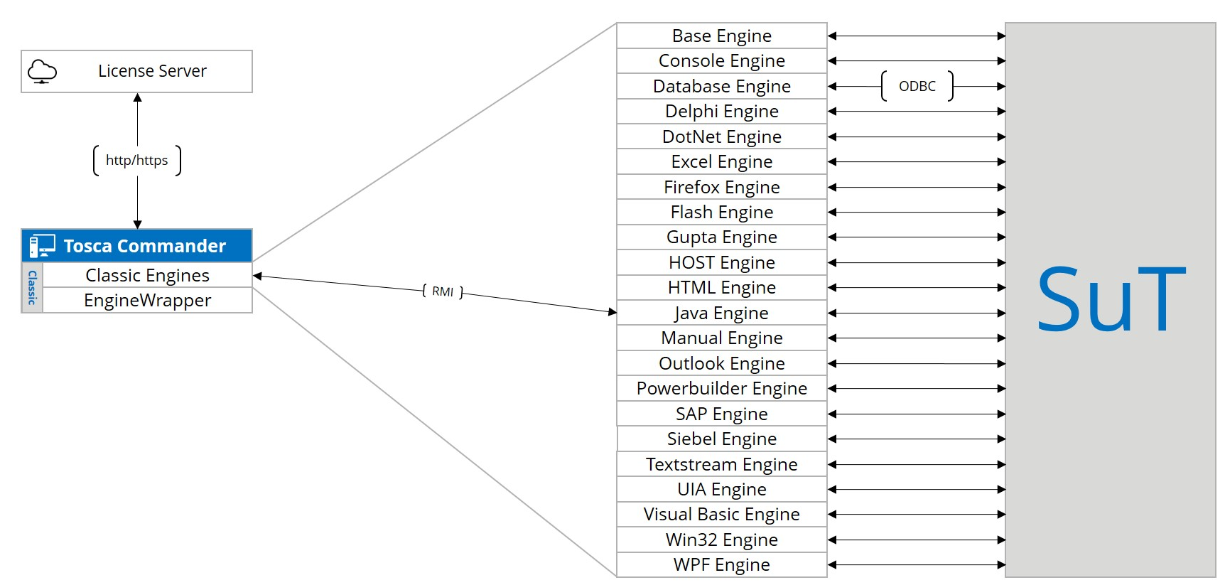
Tricentis Tosca Architecture

Slide 44
Tricentis Tosca Architecture
Tosca Engines: Tosca Engines are distributed components that execute test cases in a distributed and parallel manner.
They help improve the execution speed and efficiency of test automation by dividing the workload across multiple machines or virtual machines.

Slide 45
Tricentis Tosca Architecture
Tosca Database: Tosca uses a dedicated database to store test assets, test data, and test results.
The database facilitates data management, version control, and collaboration among team members working on the same test project.

Slide 46
Tricentis Tosca Architecture
Model-Based Architecture: Tricentis Tosca follows a model-based approach to test automation.
Test cases are created using graphical models that represent the application's user interface and business processes.
These models provide a high-level abstraction of the application, making it easier to create and maintain test cases.

Slide 47
Tricentis Tosca Architecture
Integration Capabilities: Tricentis Tosca is designed to integrate with various external tools and technologies.
It can seamlessly integrate with popular software development and testing tools, such as defect tracking systems, test management tools, continuous integration servers, and more.
This integration capability allows for end-to-end test automation and supports continuous testing practices.

Slide 48
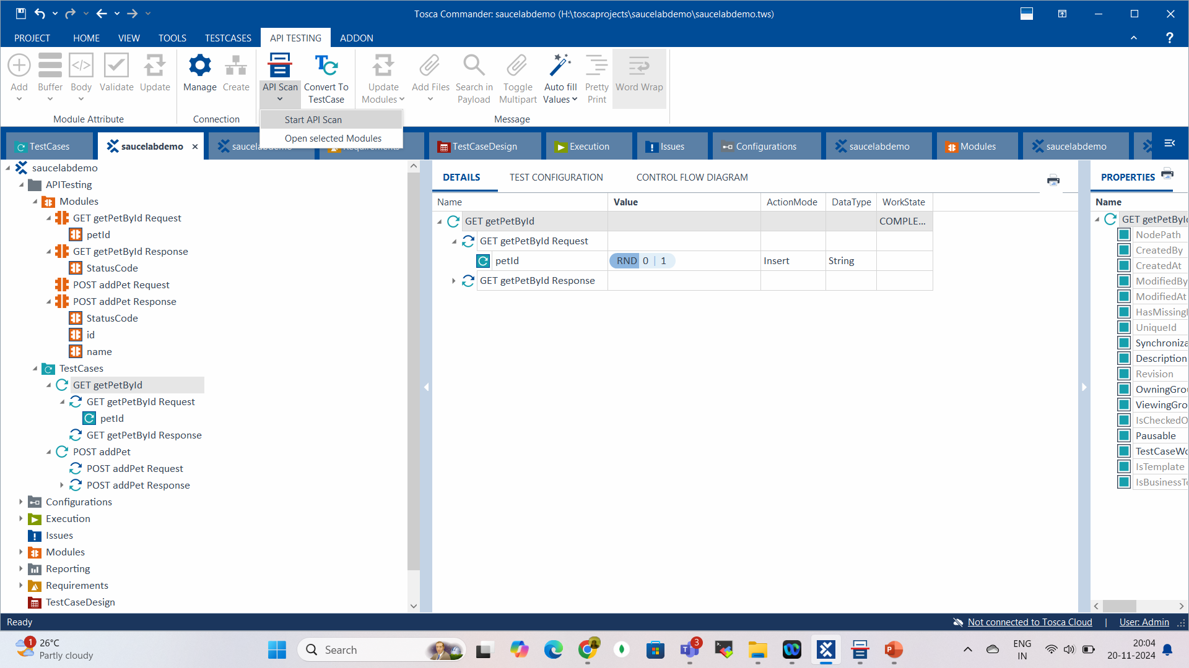

Integrate Tosca Commander and API Scan Export

Slide 49
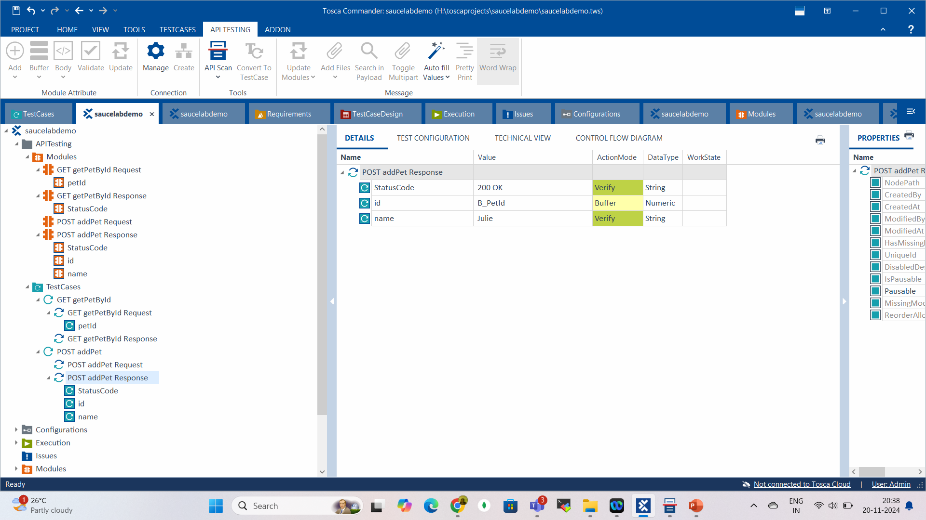
Integrate Tosca Commander and API Scan Export

Slide 50
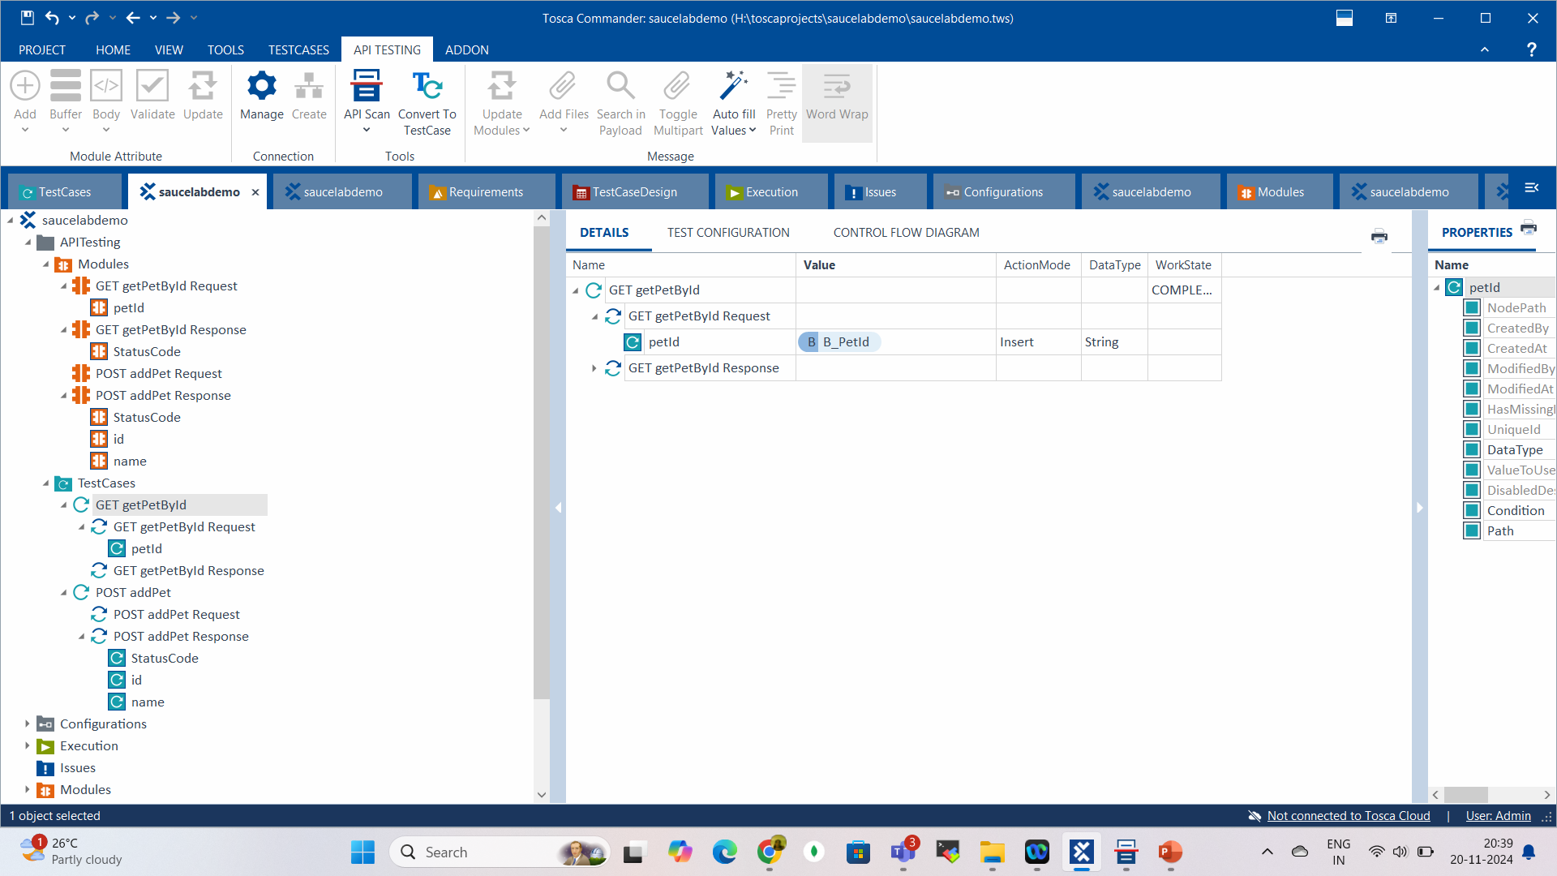

Integrate Tosca Commander and API Scan Export

Slide 51
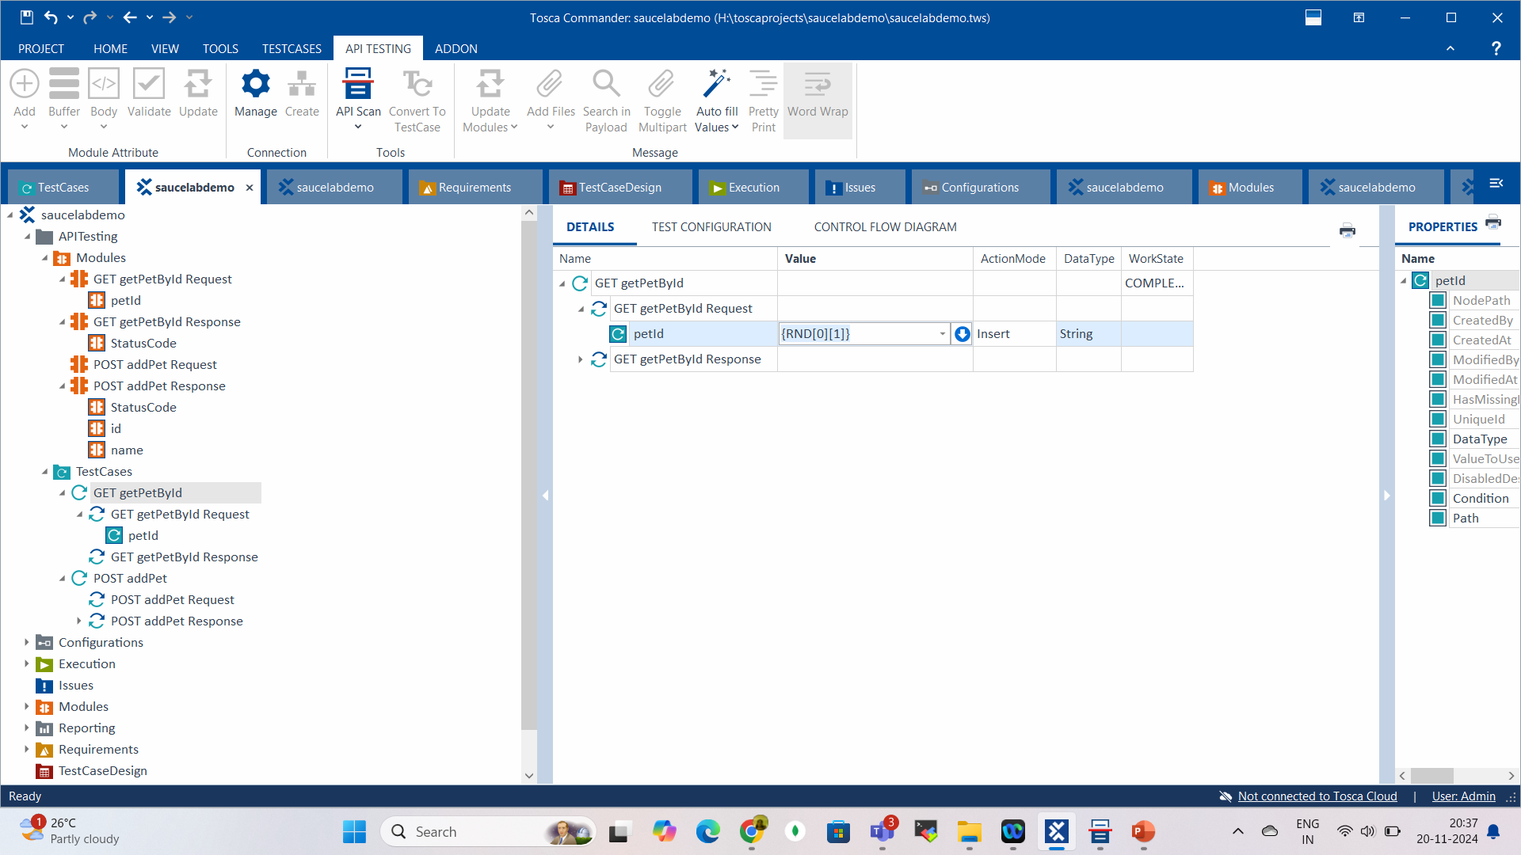

Integrate Tosca Commander and API Scan Export

Slide 52
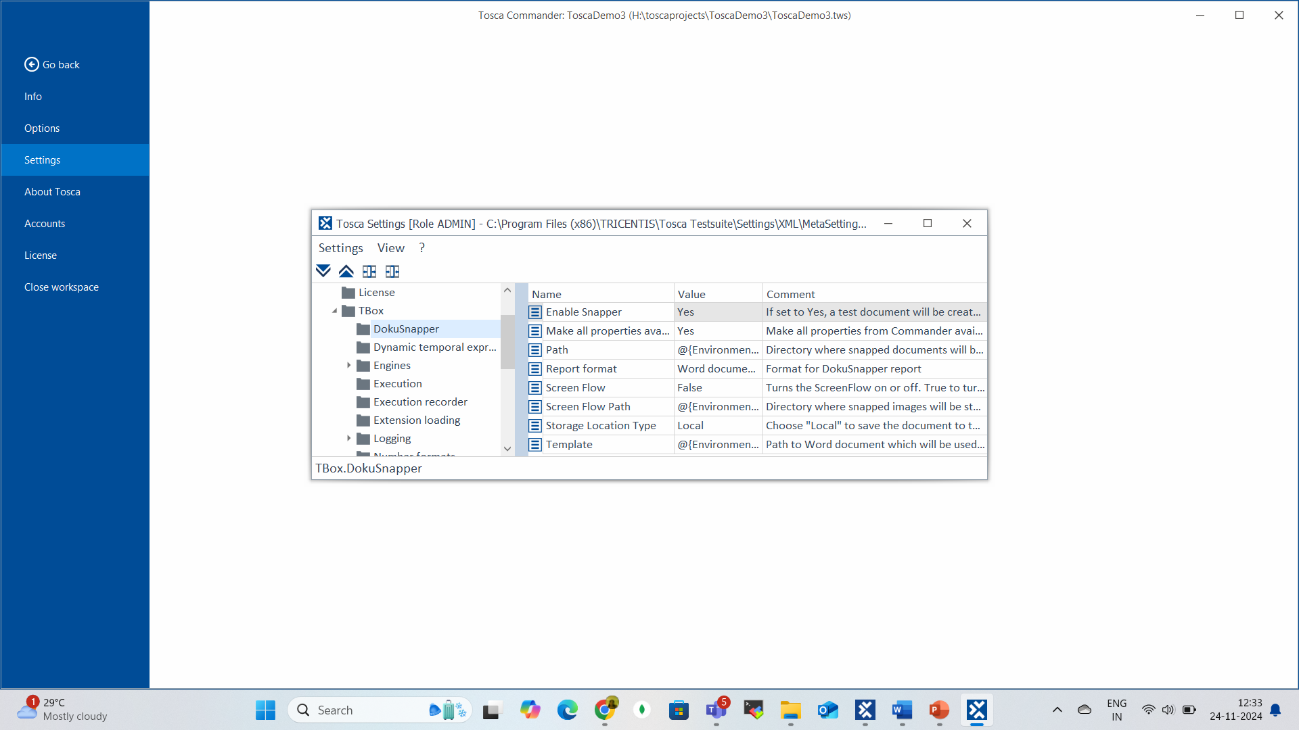

Tosca DocuSnapper

Slide 53
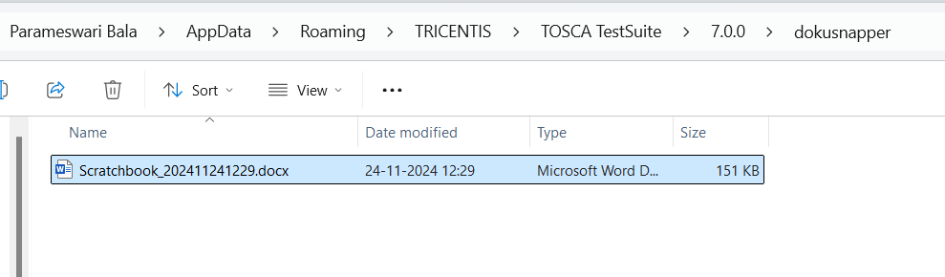
Tosca DocuSnapper

Slide 54
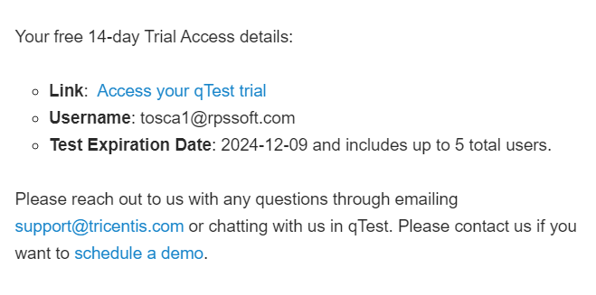
Qtest

Slide 55
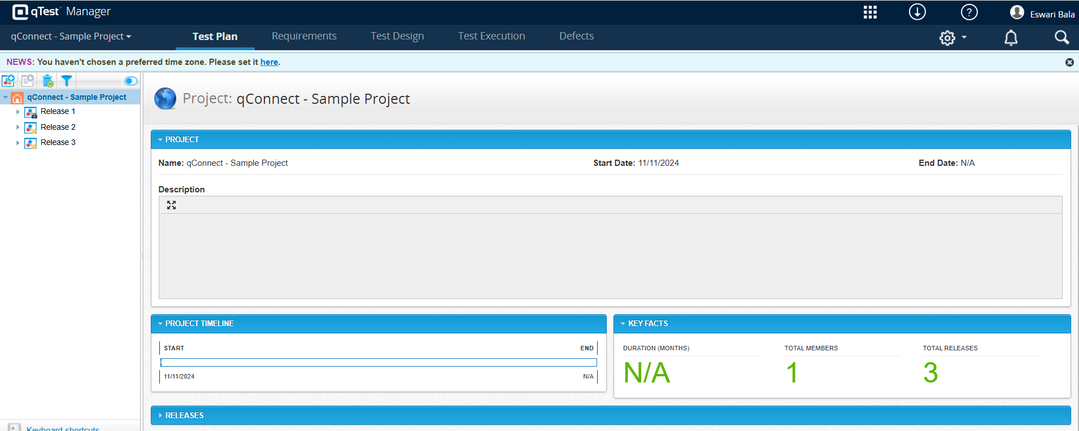
Qtest

Slide 56
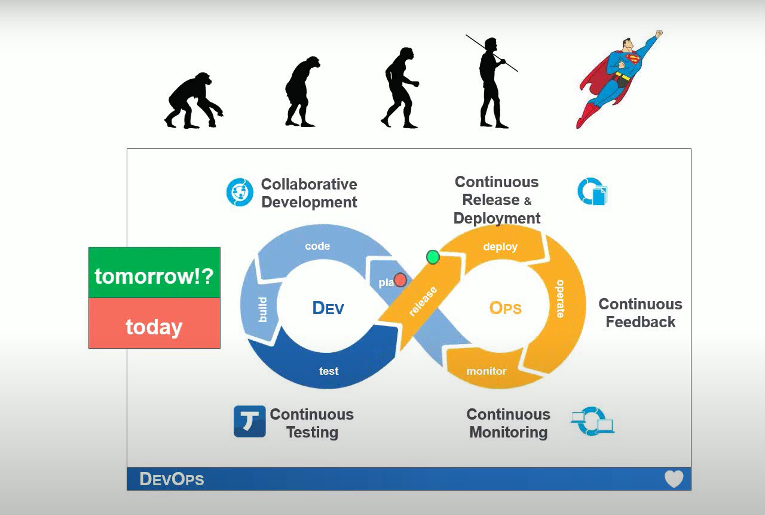
Continuous Integration

Slide 57
qTest – Test Management Tool
qTest is the test management tool that is both easy to use and powerful.
It provides various features that will make your testing much more effortless.
qTest is a comprehensive test management tool that provides a user-friendly interface for managing all tests.
It includes test data management, automatic test execution, and reporting.
qTest also integrates with popular automation tools such as Selenium, Appium, and SoapUI.
In addition, the qTest management tool provides a comprehensive API for integration with third-party tools.

Slide 58
Advantages of qTest
Cloud-Based Test Management Tool
Allow Coordinating Teams Across Multiple Locations
Supports Agile Testing Tools Result in Rapid Deployment of Product
Automatically Create a Detailed Defect Document
Ability to Add Notes and Annotations
Easy Sharing Option

Slide 59
The Top Uses of the qTest Tool
Bug Tracking
Project Management

Slide 60
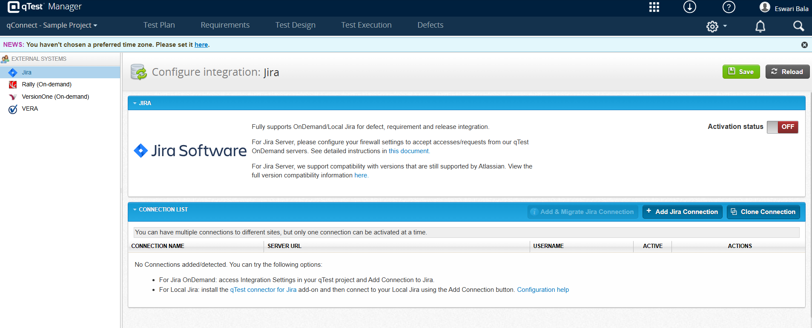
qTest with Jira

Slide 61
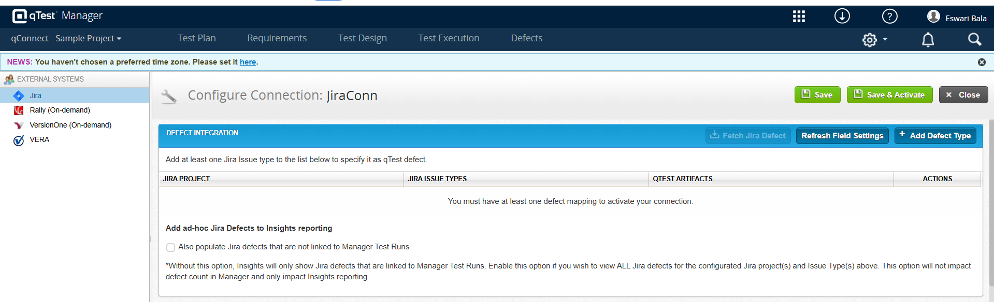
qTest with Jira

Slide 62
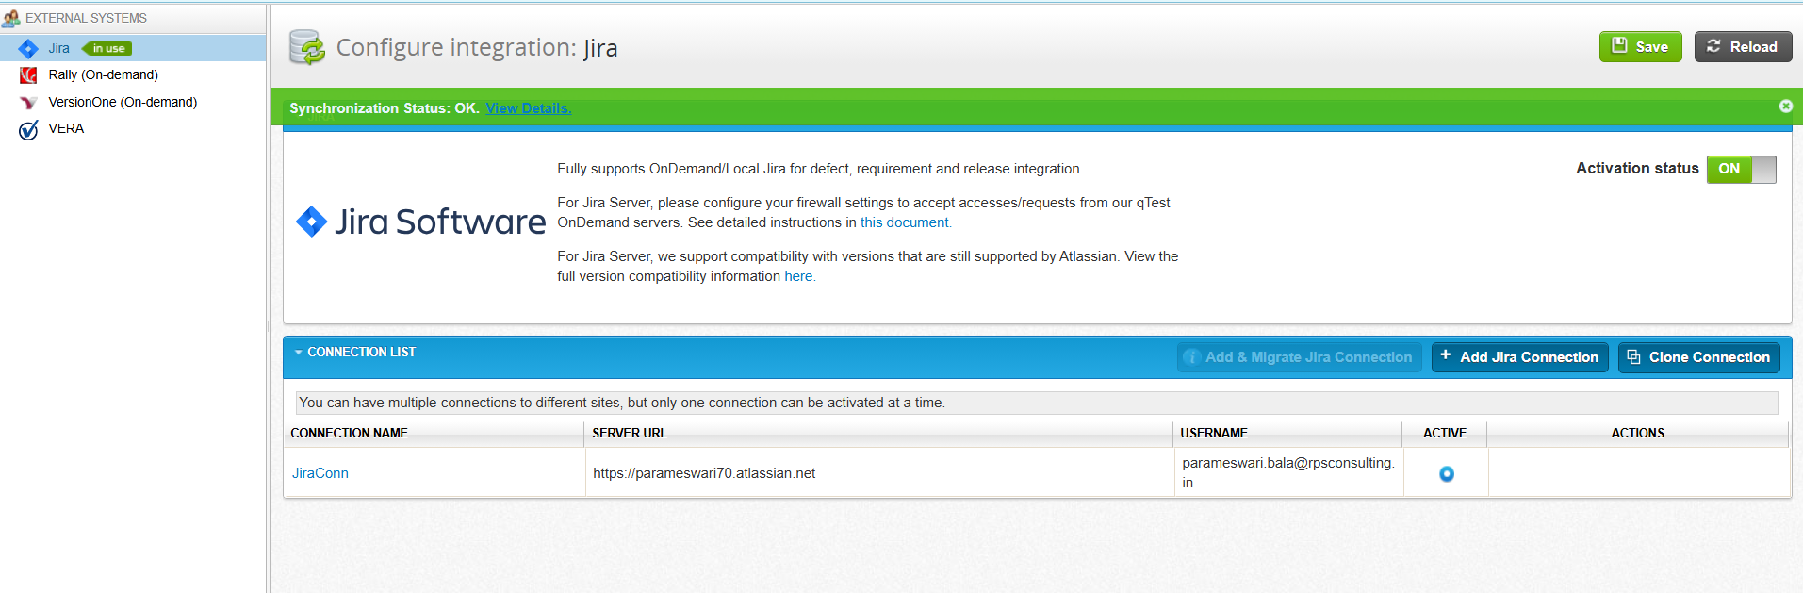
qTest with Jira

Slide 63
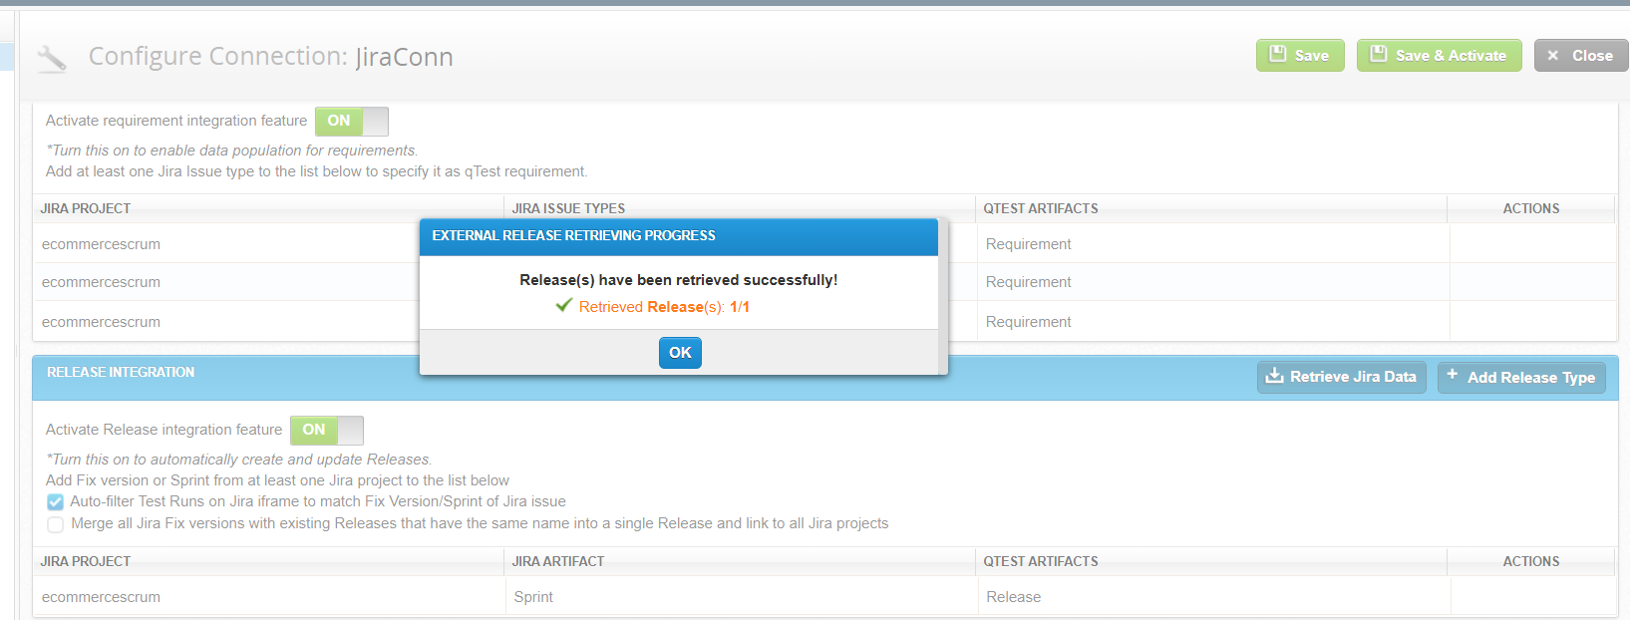
qTest with Jira

Slide 64
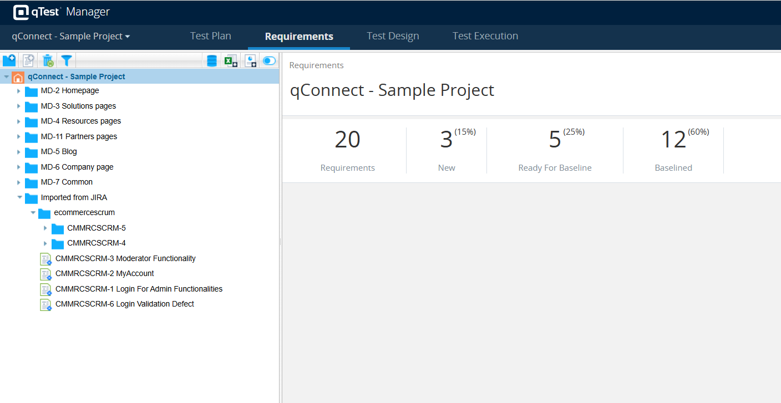
qTest with Jira

Slide 65
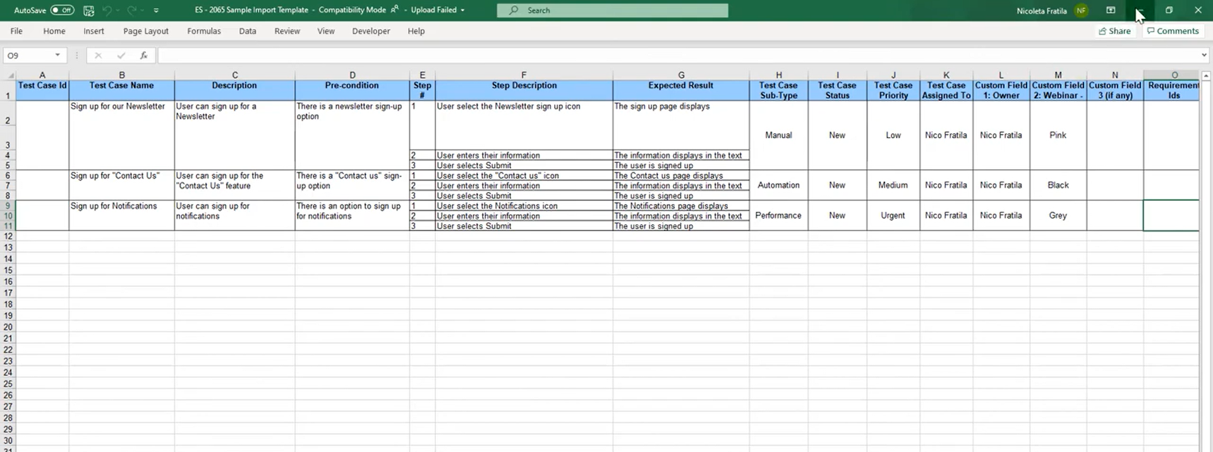
qTest with Excel

Slide 66
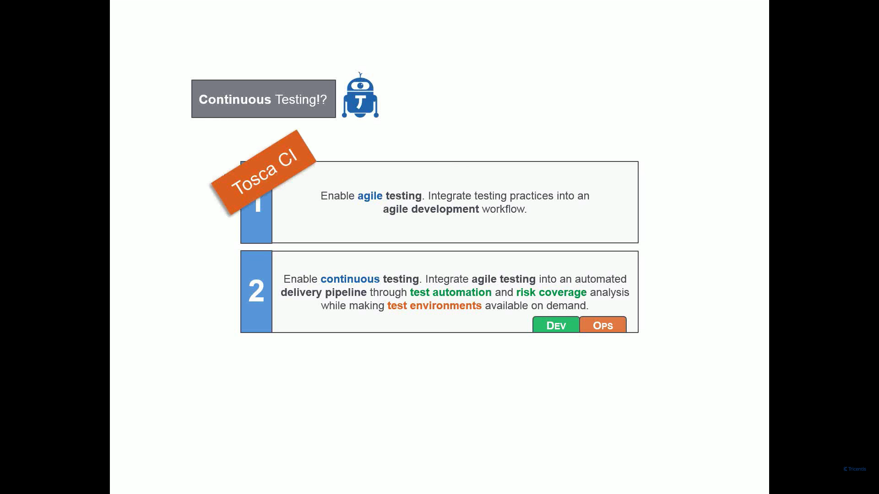
Continuous Integration

Slide 67
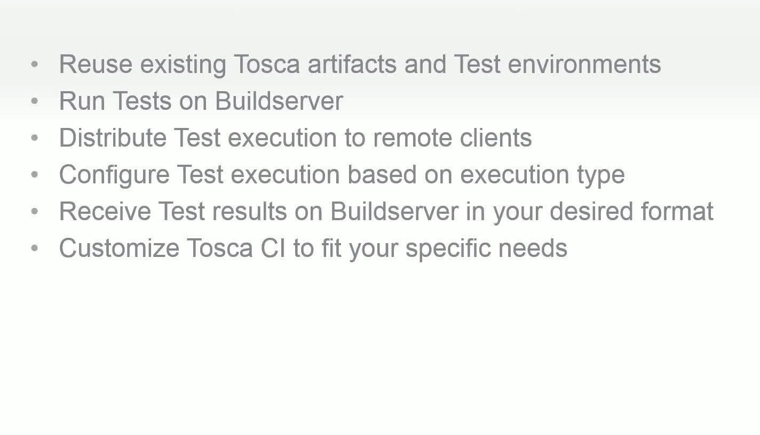
TOSCA CI Key Features

Slide 68
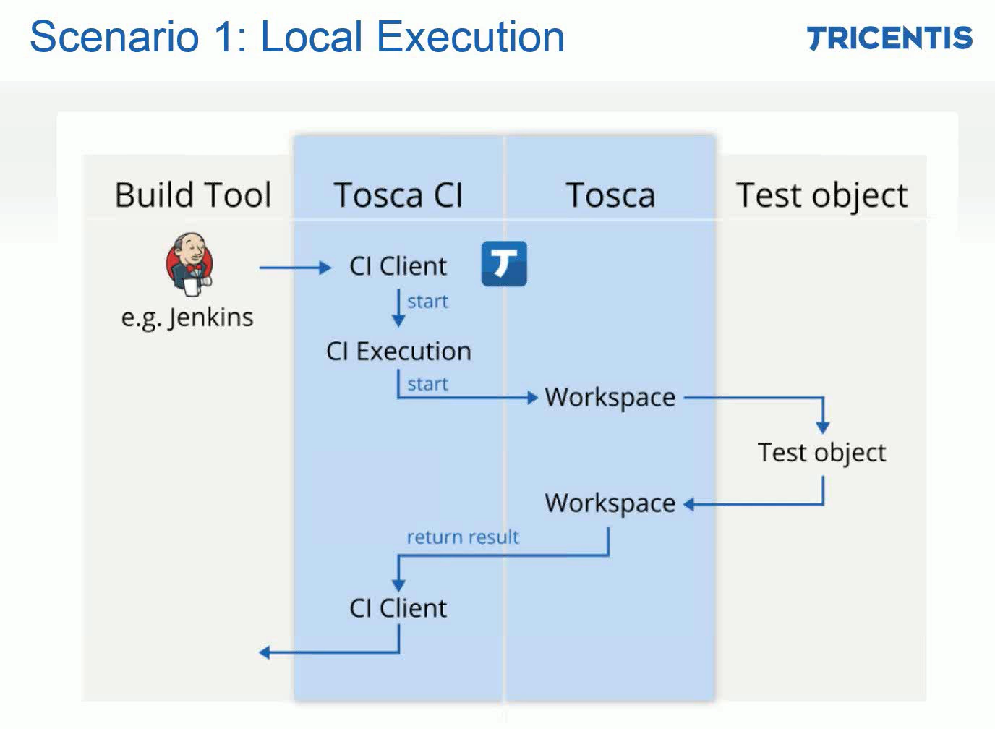
TOSCA CI Key Features

Slide 69
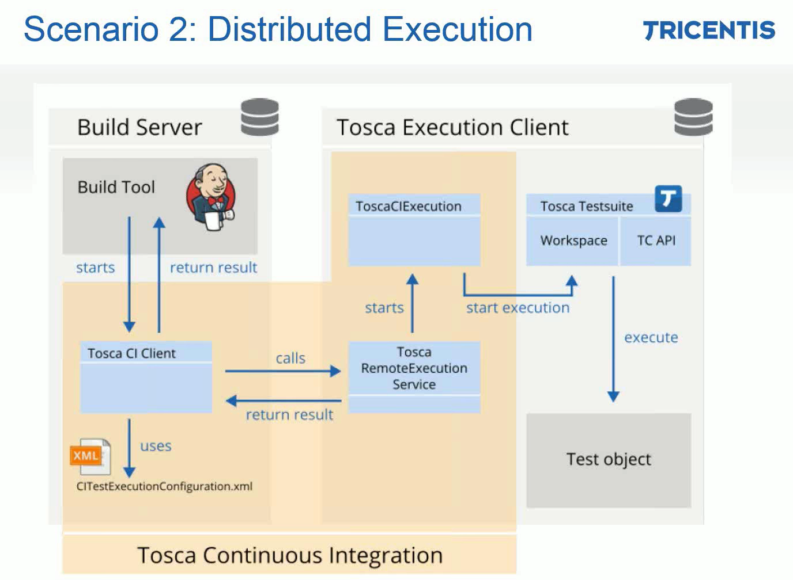
TOSCA CI Key Features

Slide 70
Tosca Server License
https://www.qascript.com/blog/how-to-get-training-license-for-tricentis-tosca

Slide 71
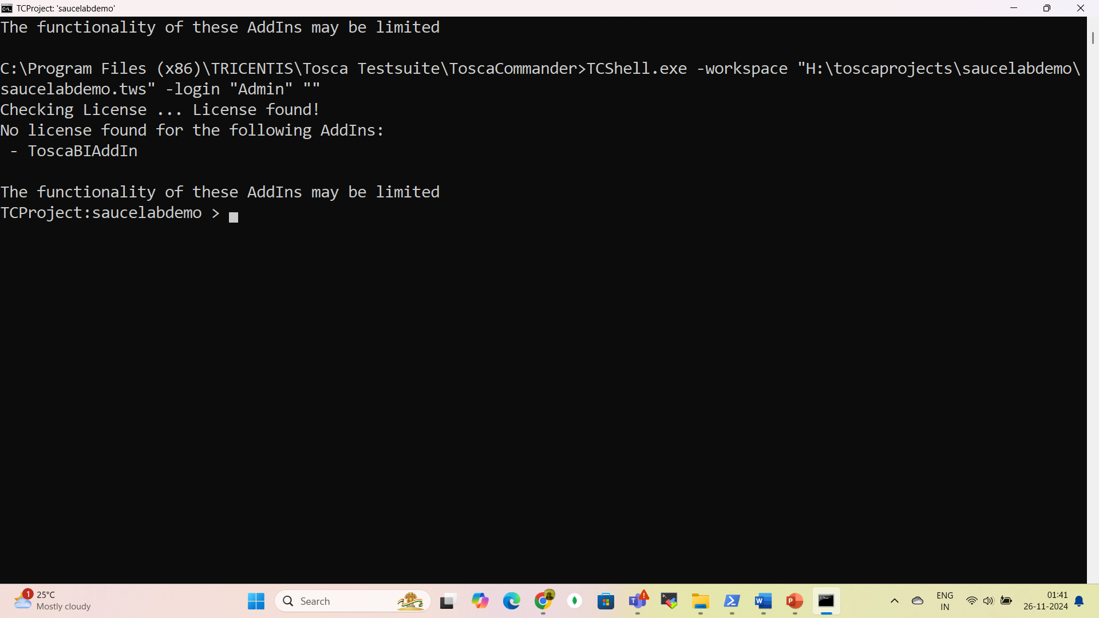
TOSCA Jenkins/Azure

Slide 72
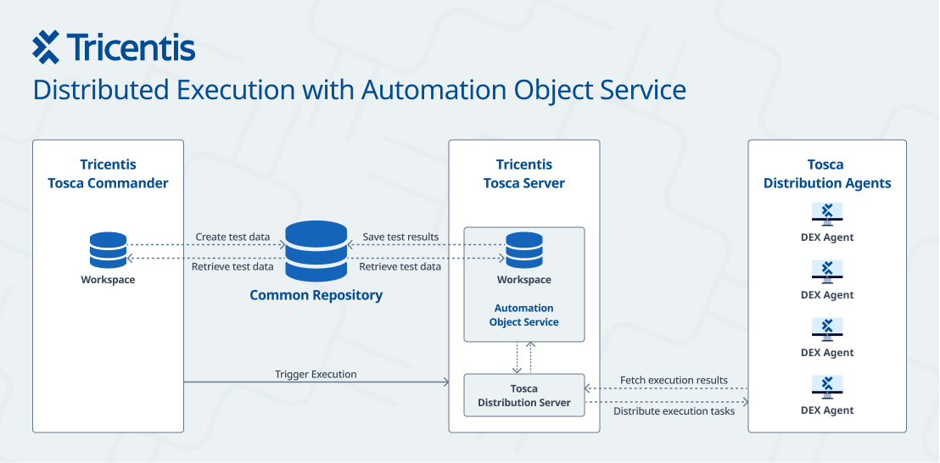
Tosca CI/CD

Slide 73
Azure Pipeline Agent
https://learn.microsoft.com/en-us/azure/devops/pipelines/agents/windows-agent?view=azure-devops

Slide 74
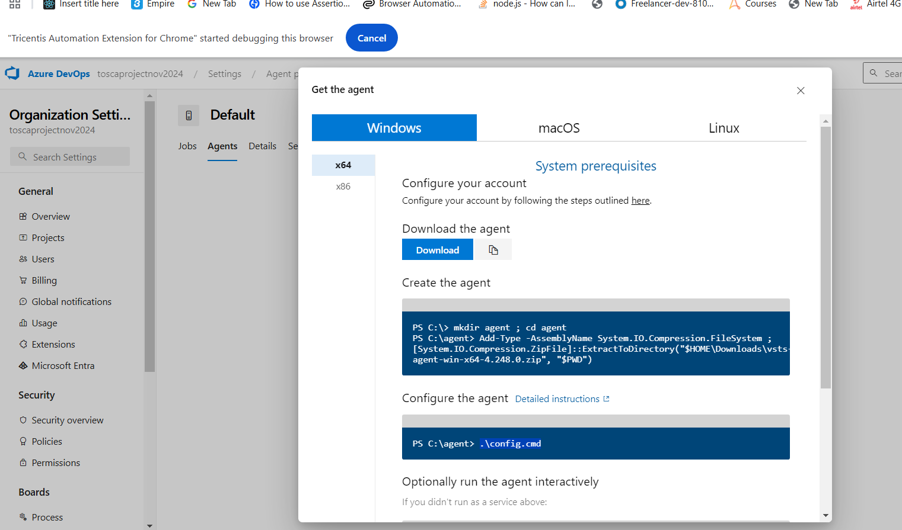
Azure Pipeline Agent

Slide 75
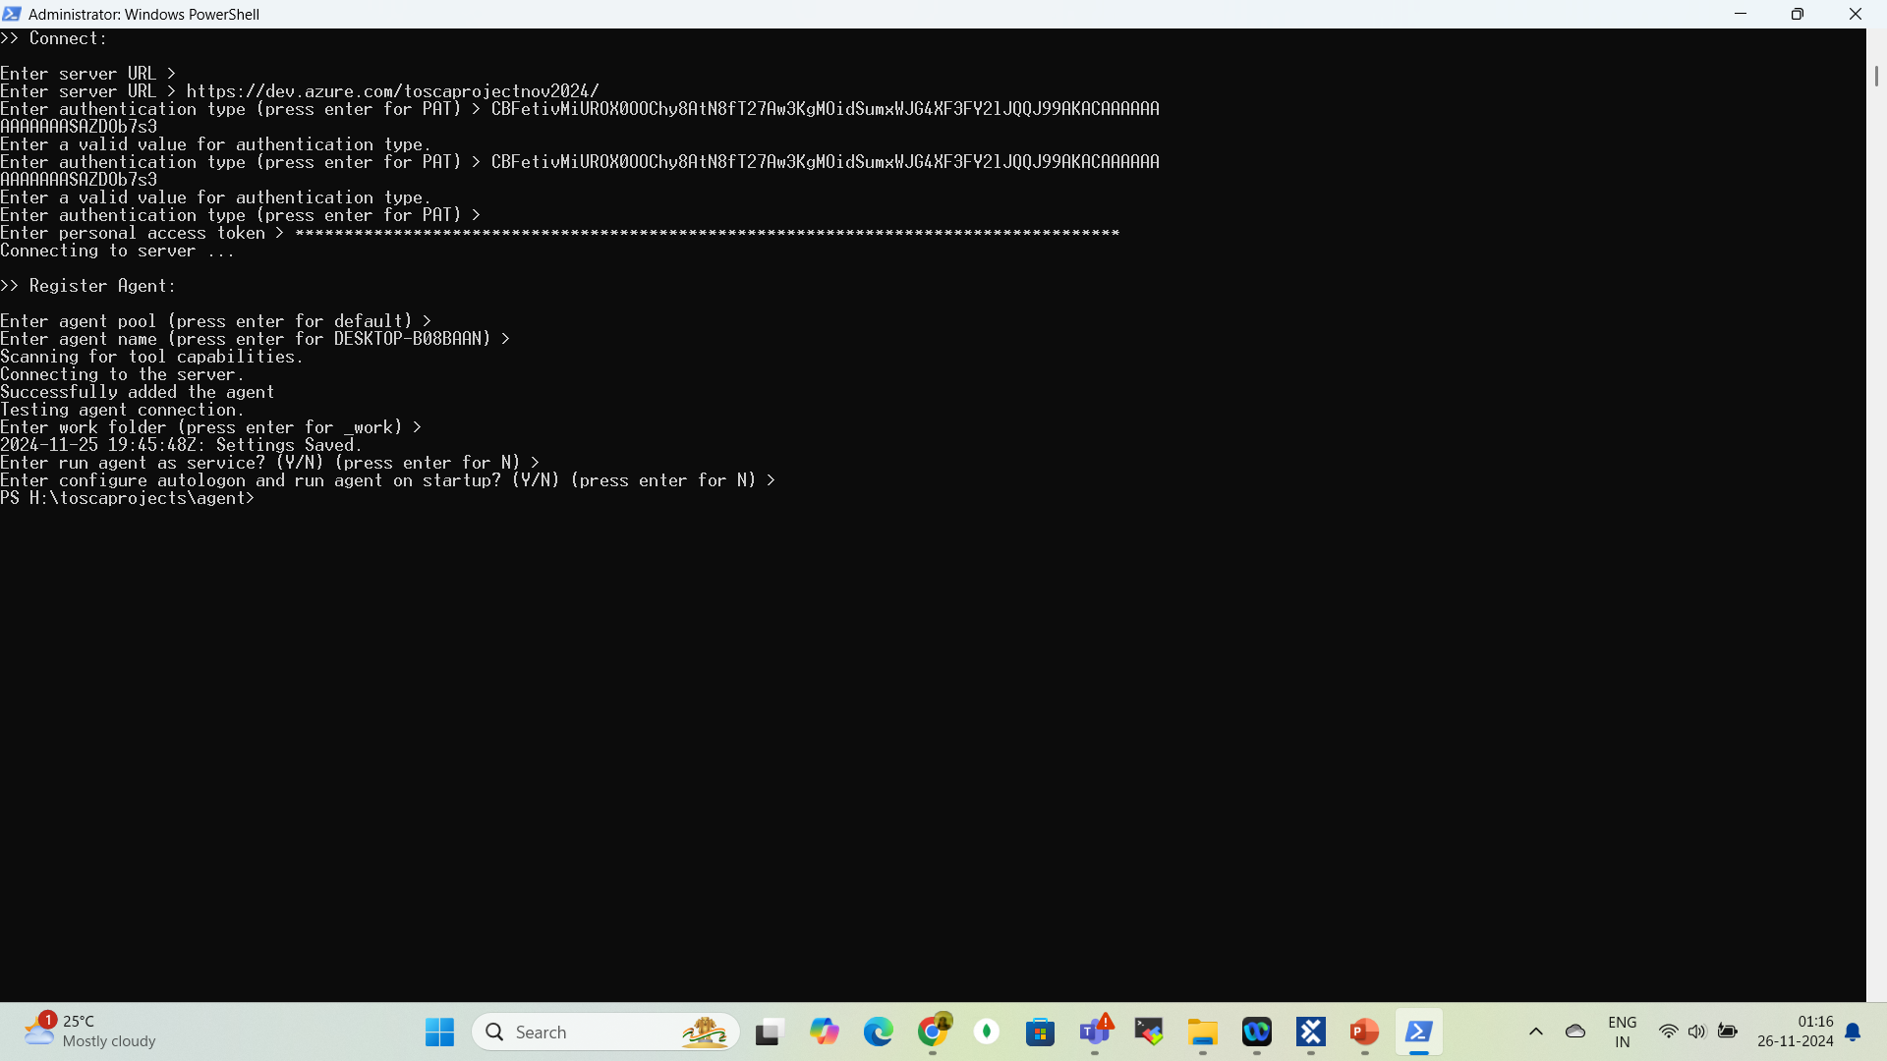
Azure Pipeline Agent

Slide 76
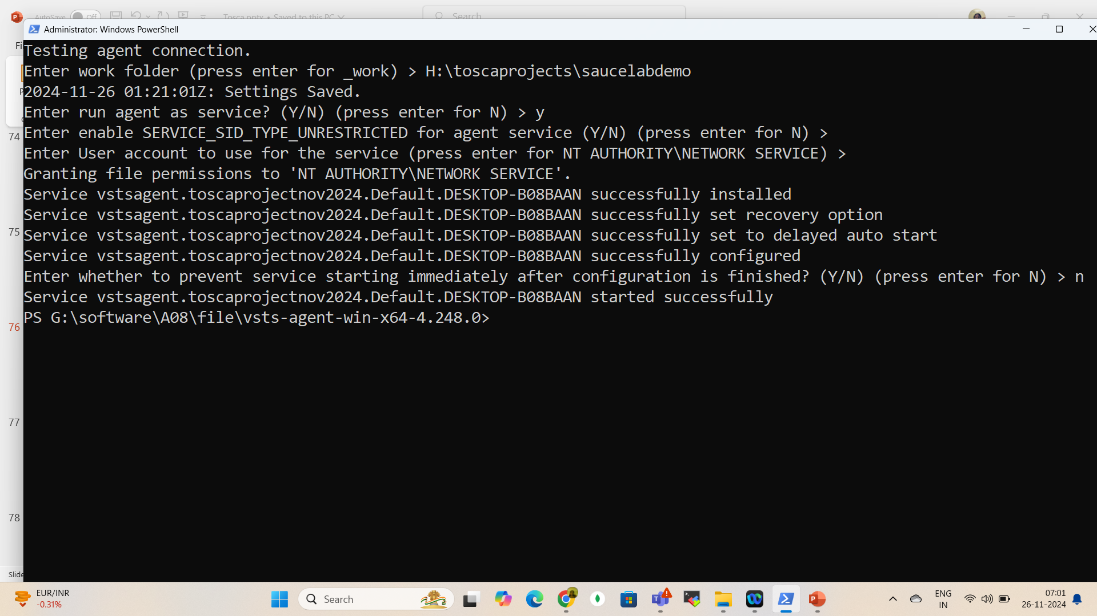
Azure Pipeline Agent

Slide 77
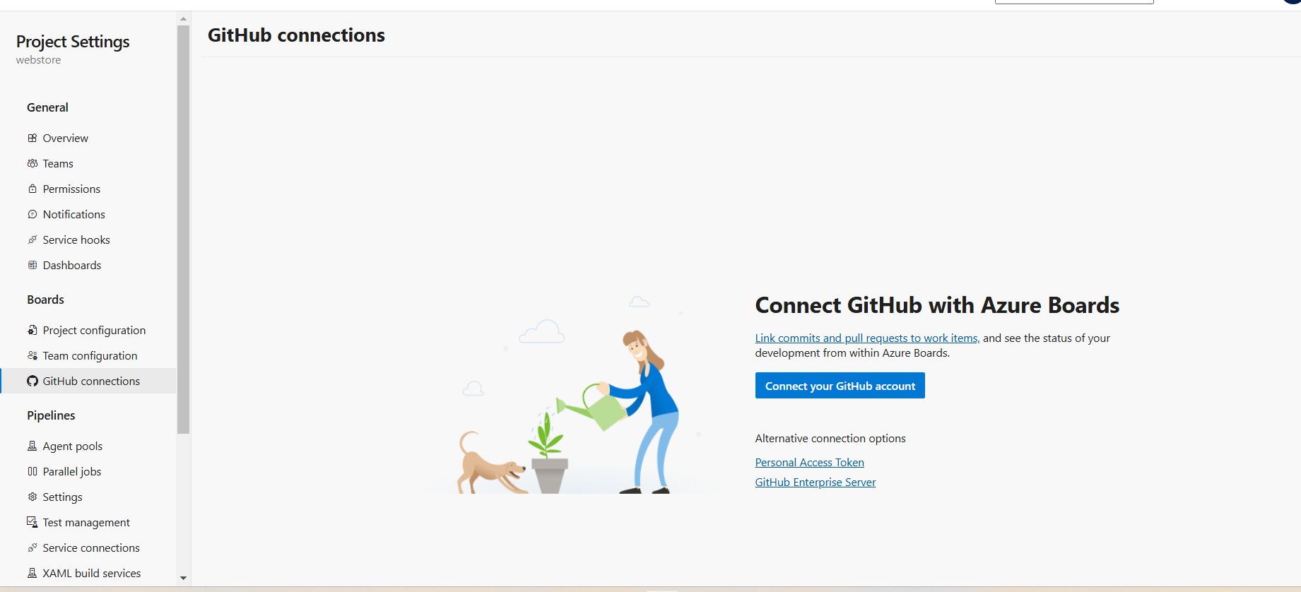
Azure github Connection

Slide 78
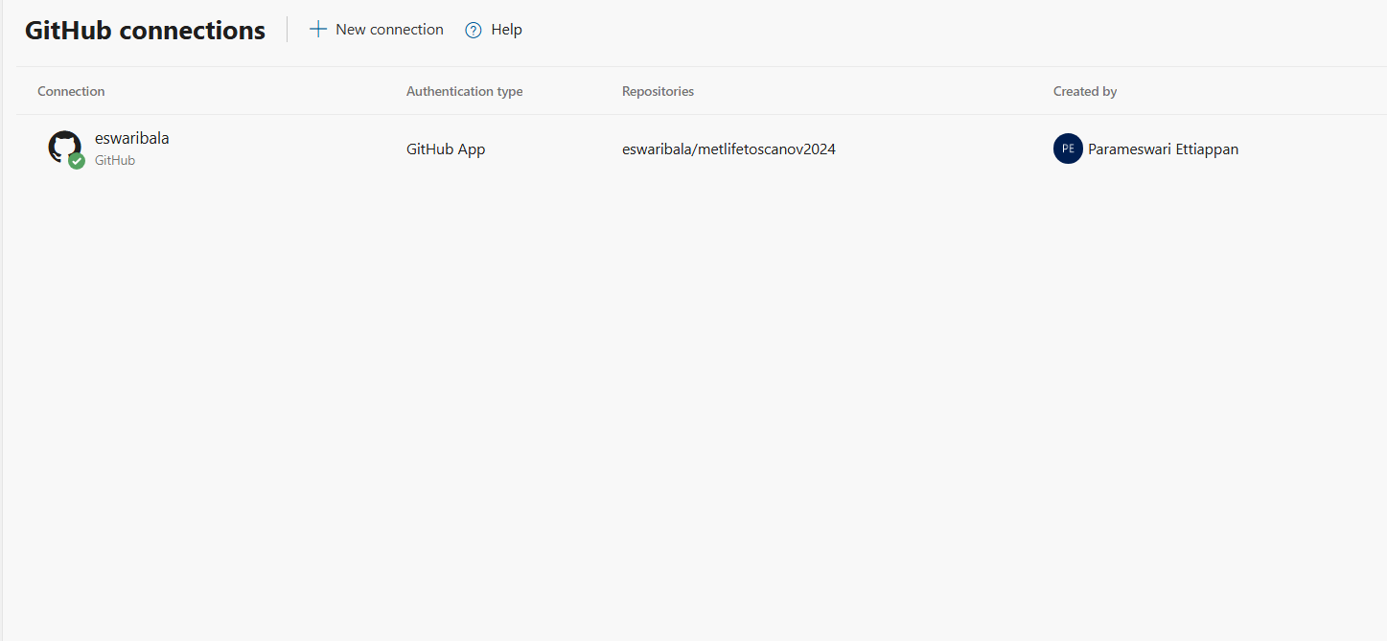
Azure github Connection

Slide 79
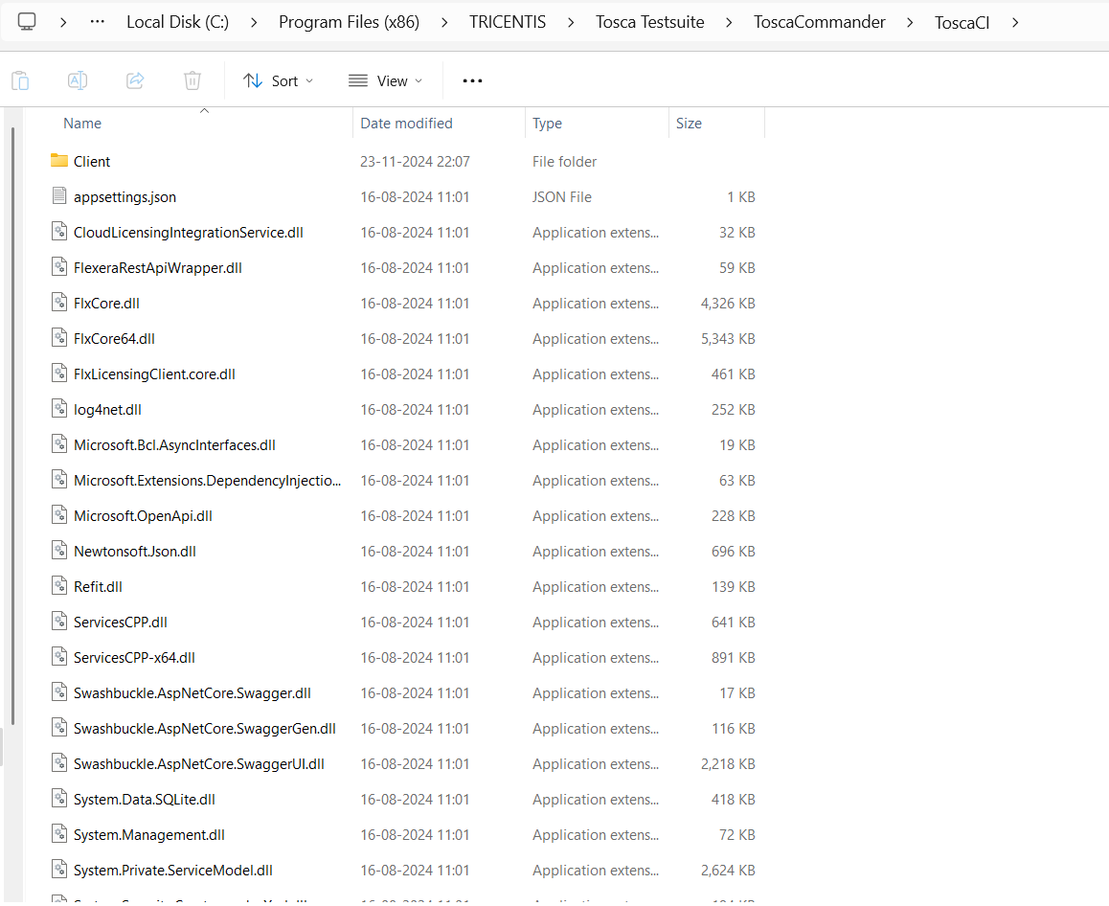
TOSCA CI

Slide 80
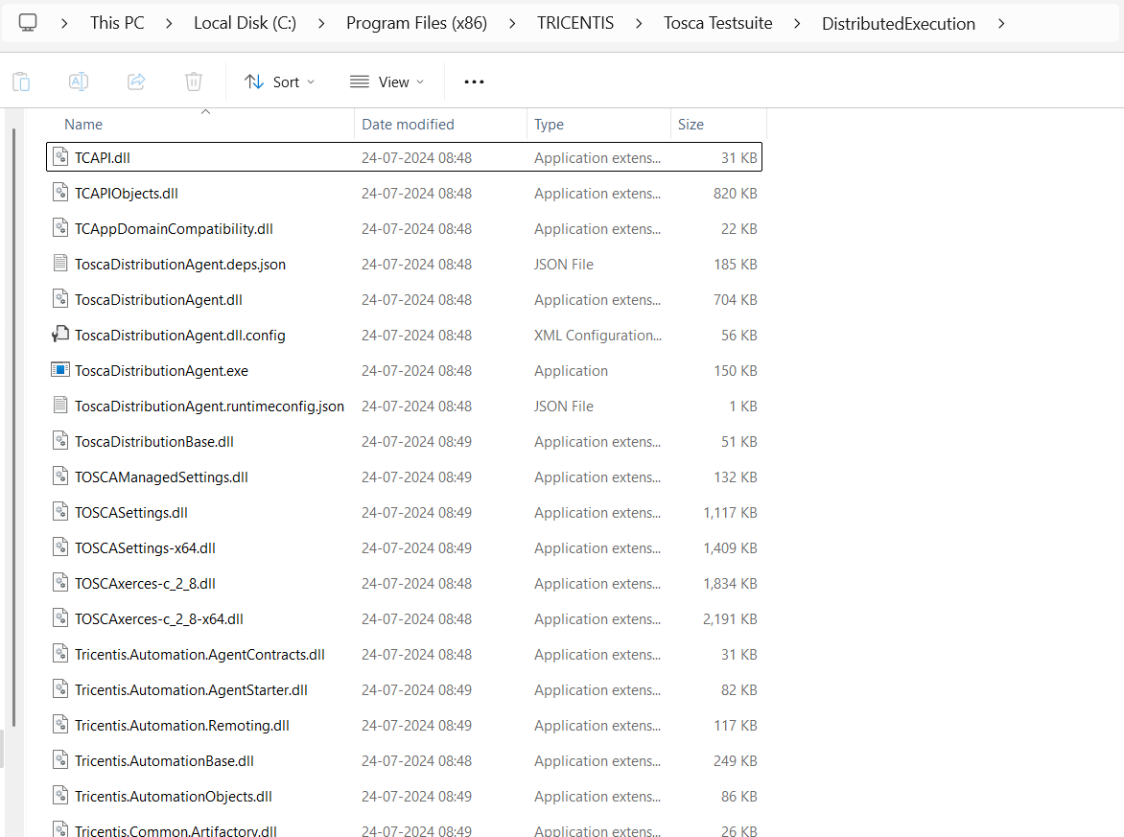

TOSCA CI

Slide 81
TOSCA CI

Slide 82
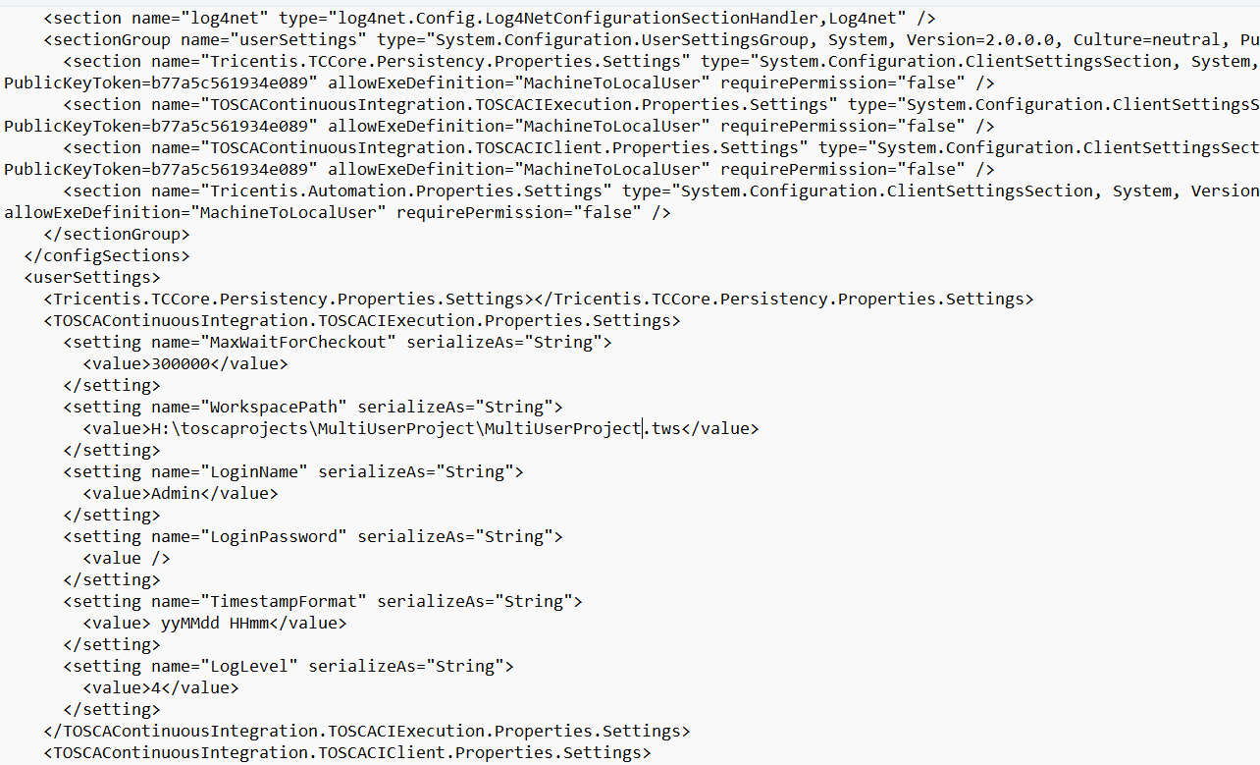
TOSCA CI

Slide 83
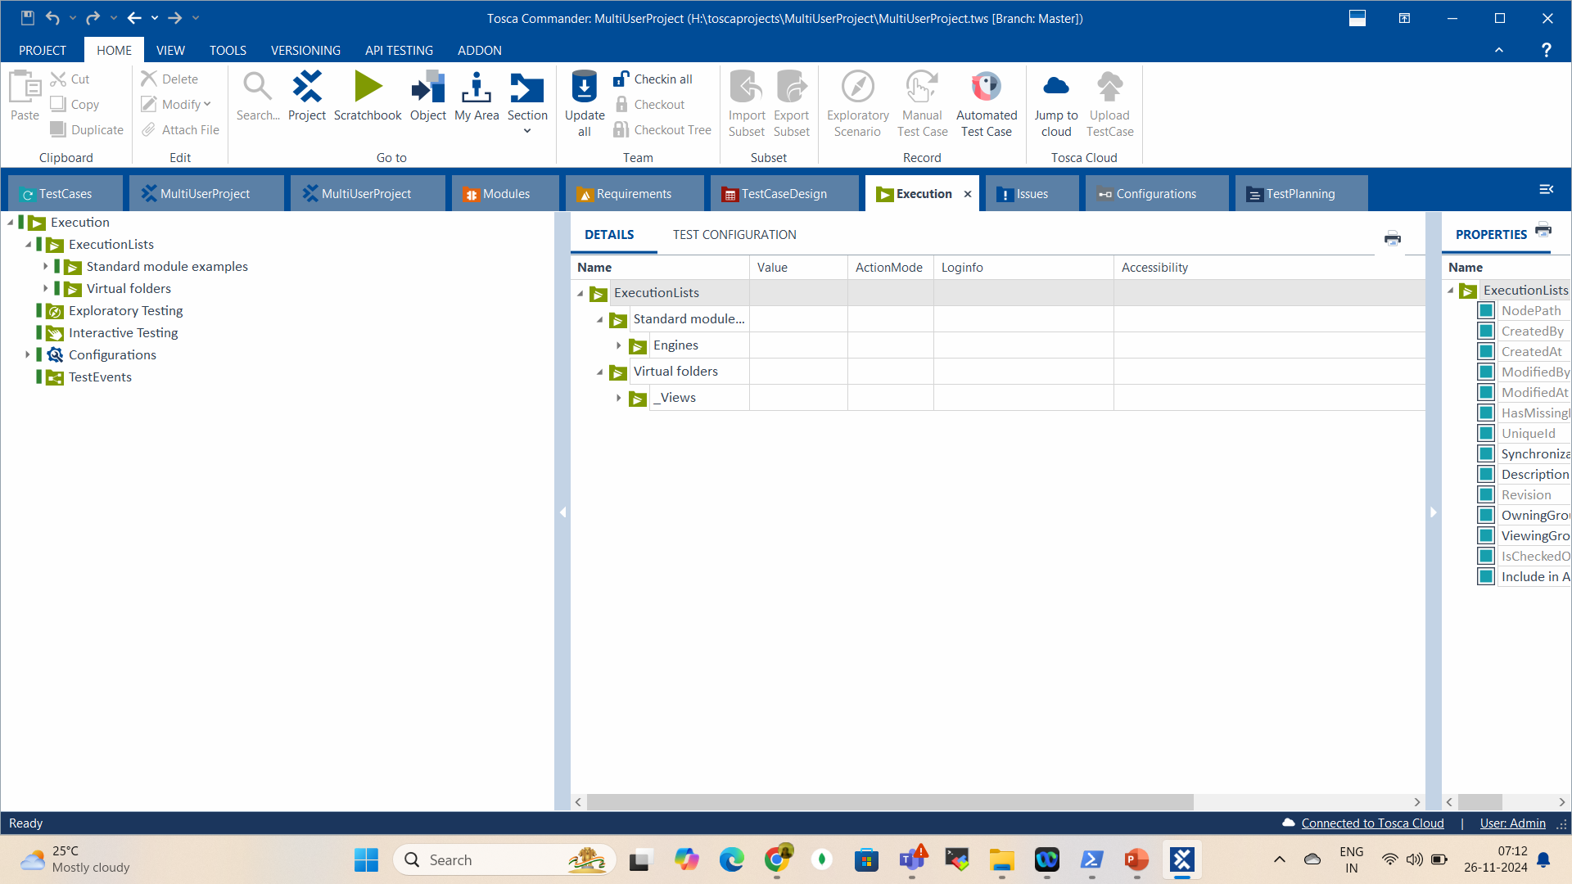



TOSCA CI
Check out all

Slide 84
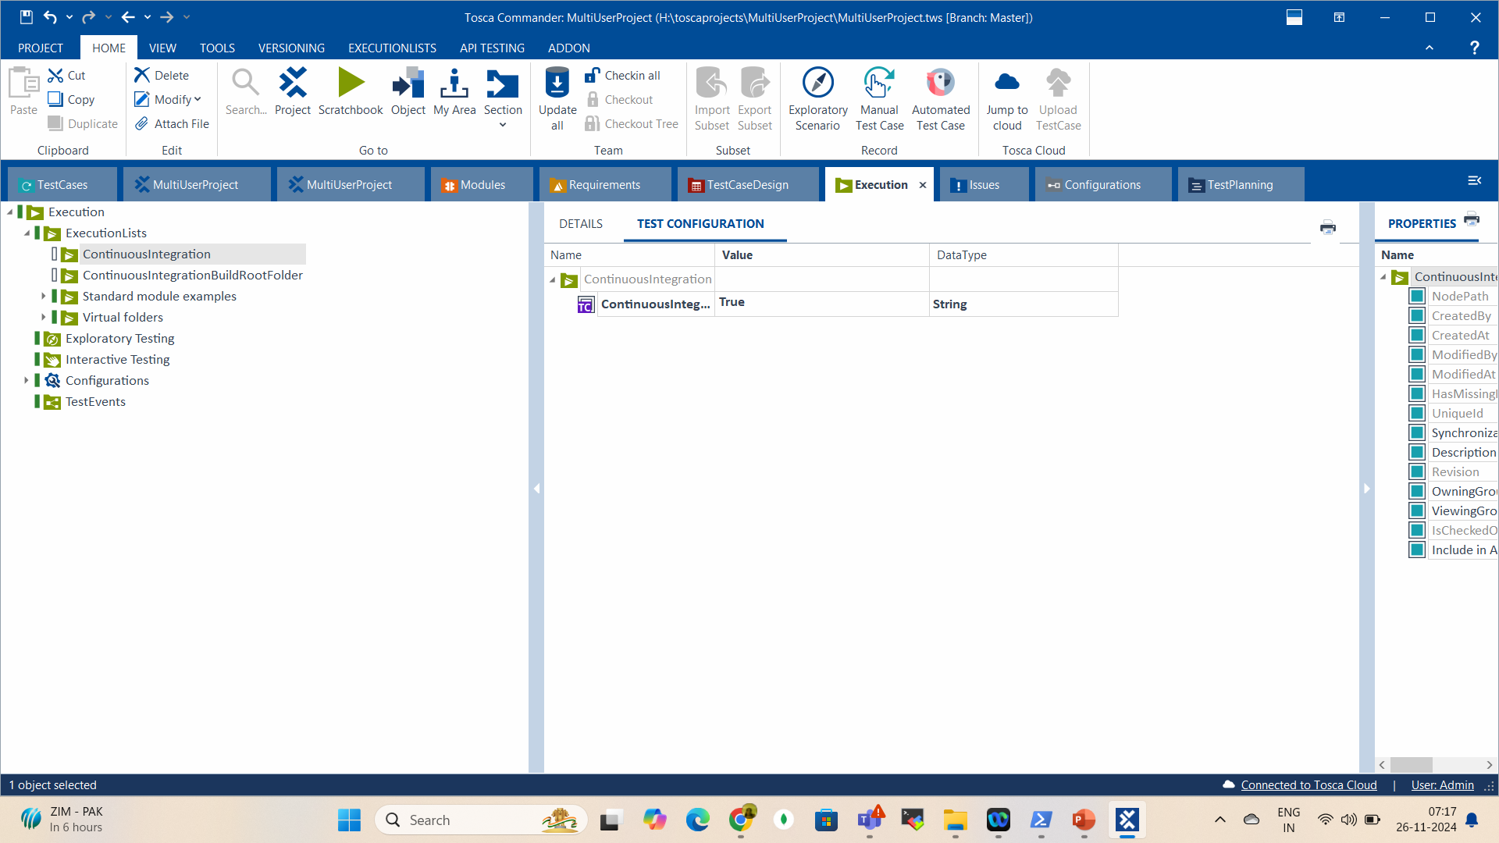
TOSCA CI

Slide 85
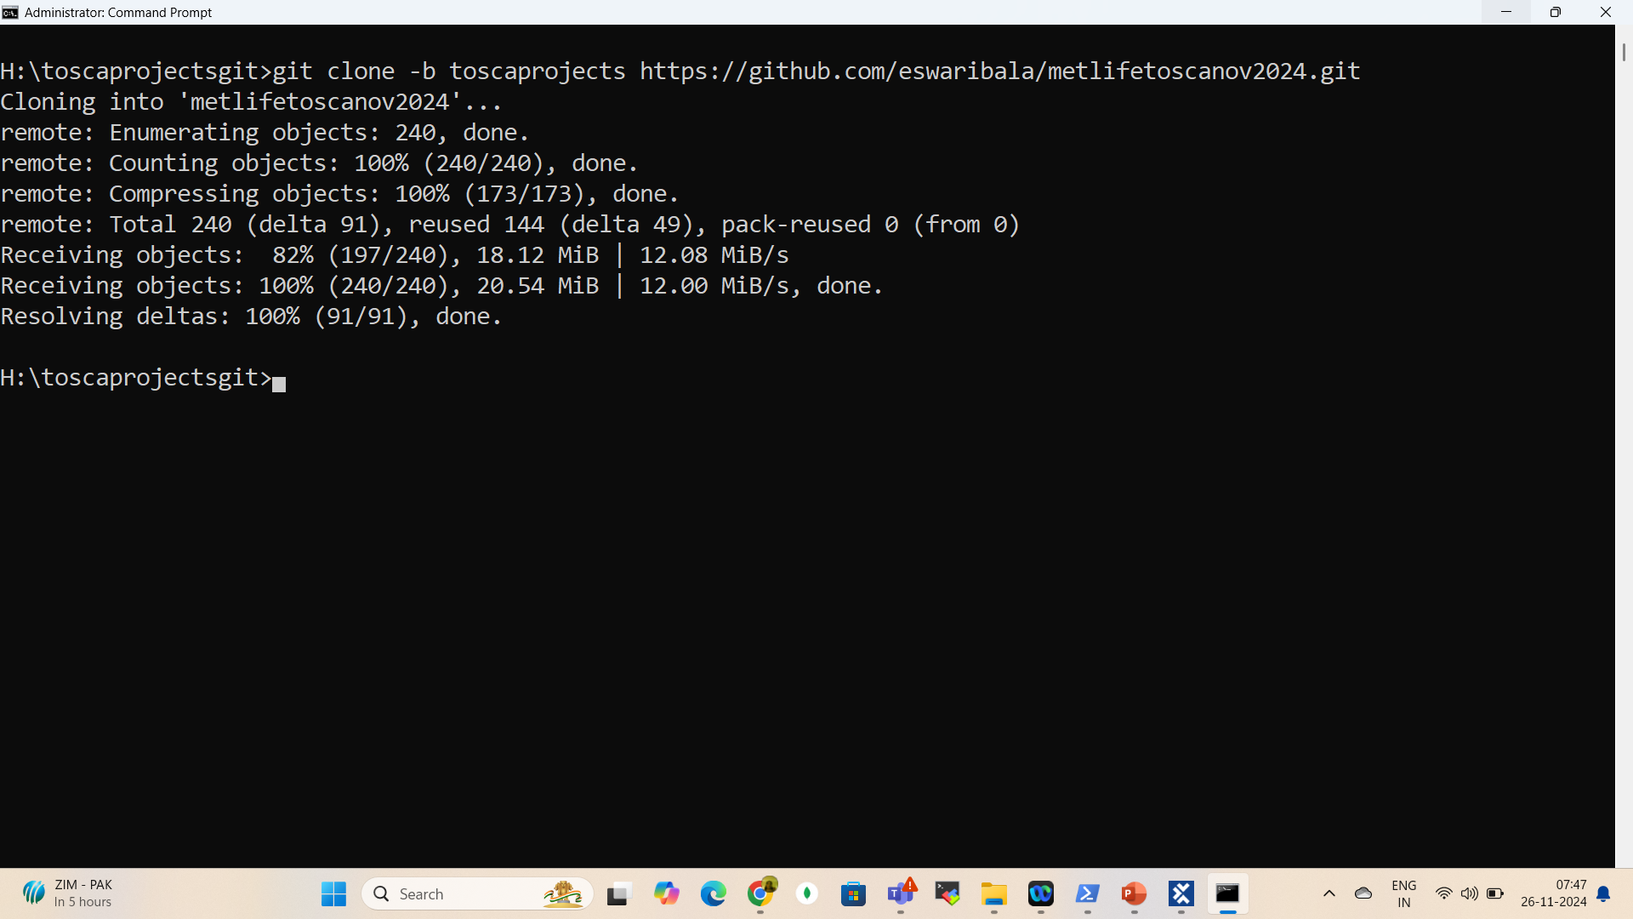
TOSCA CI

Slide 86
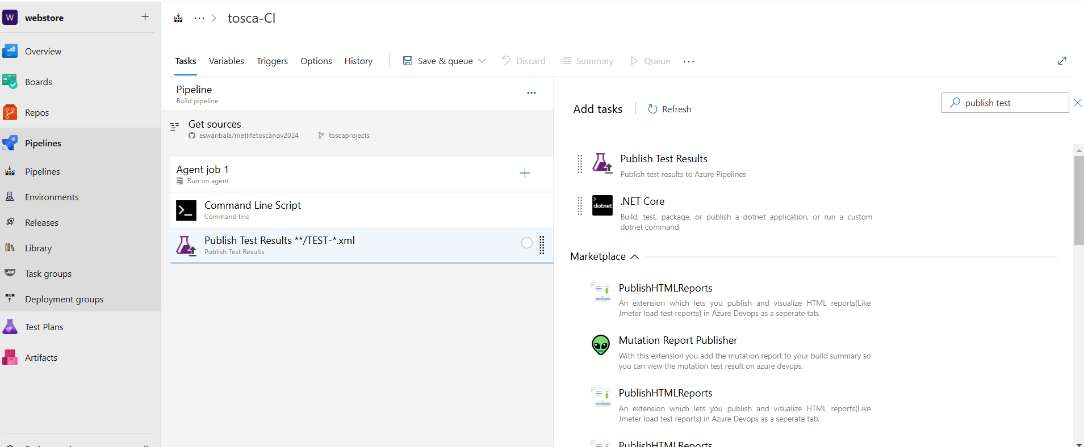
TOSCA CI – Classic Pipeline

Slide 87
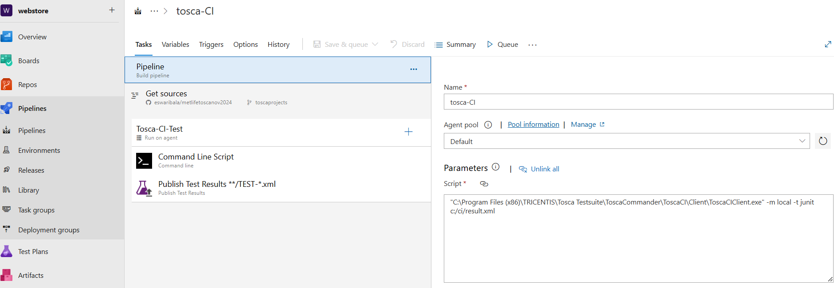
TOSCA CI – Classic Pipeline

Slide 88
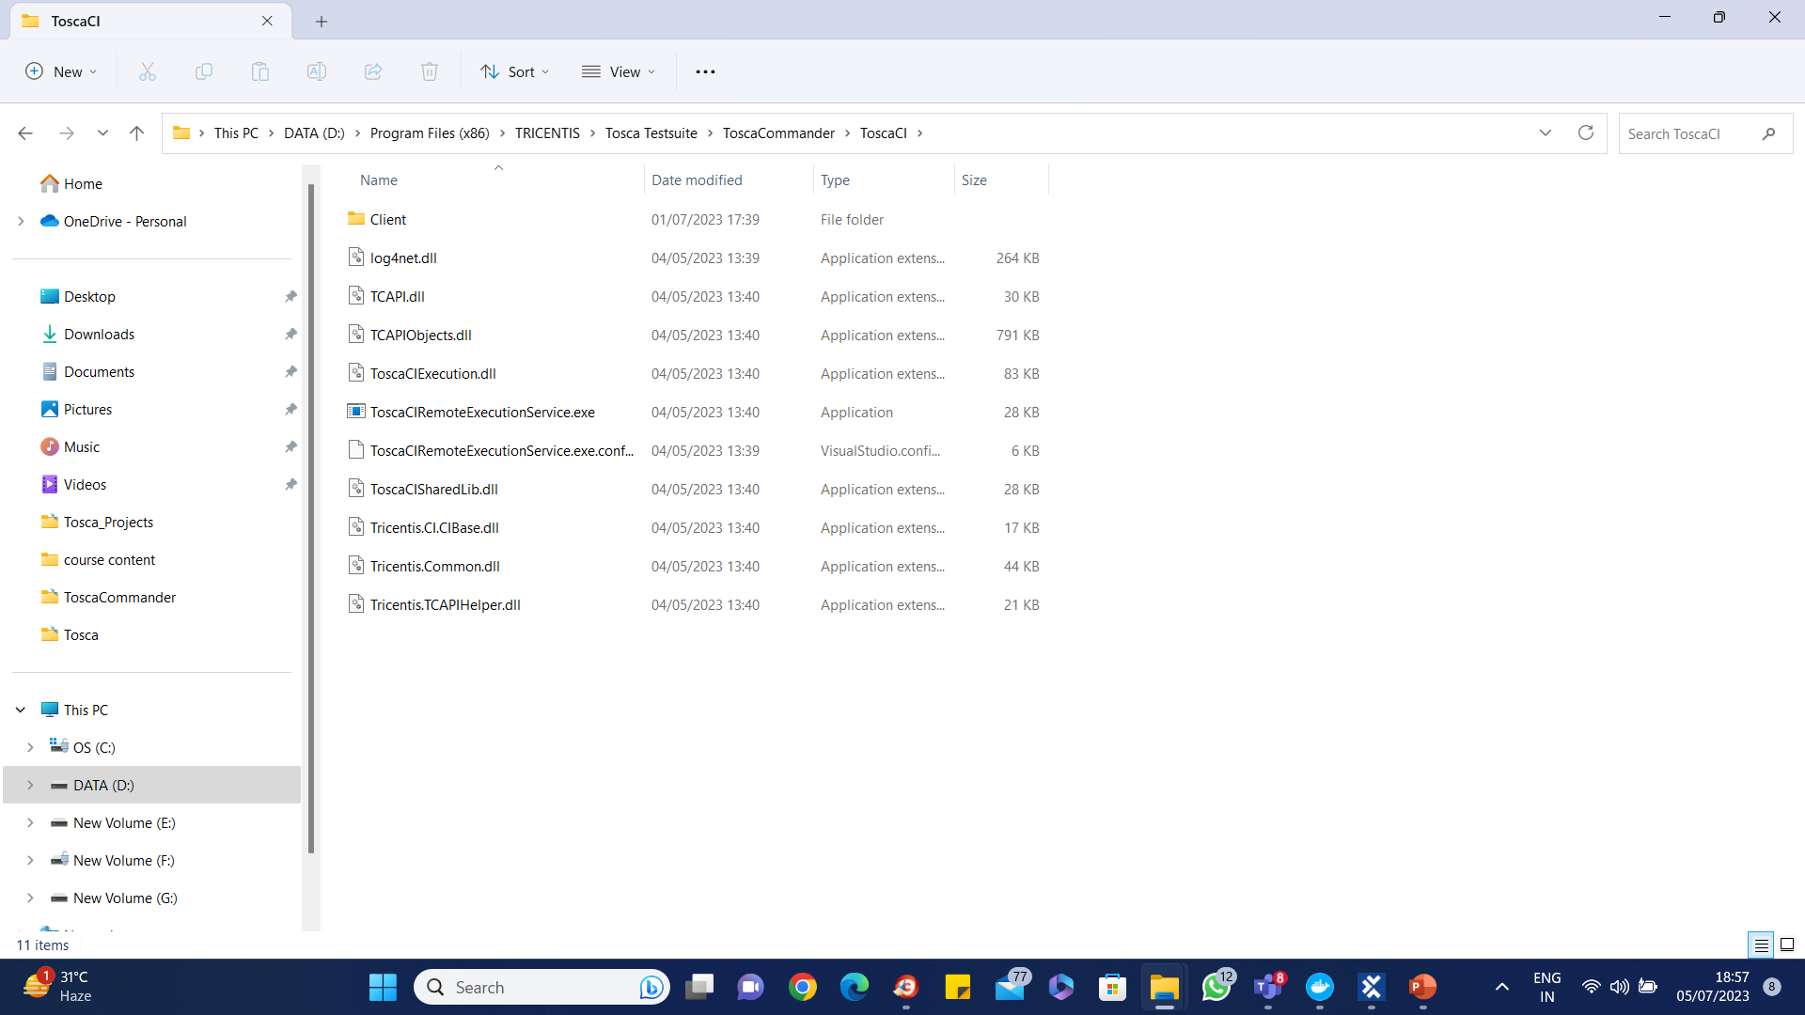
TOSCA CI Key Features

Slide 89
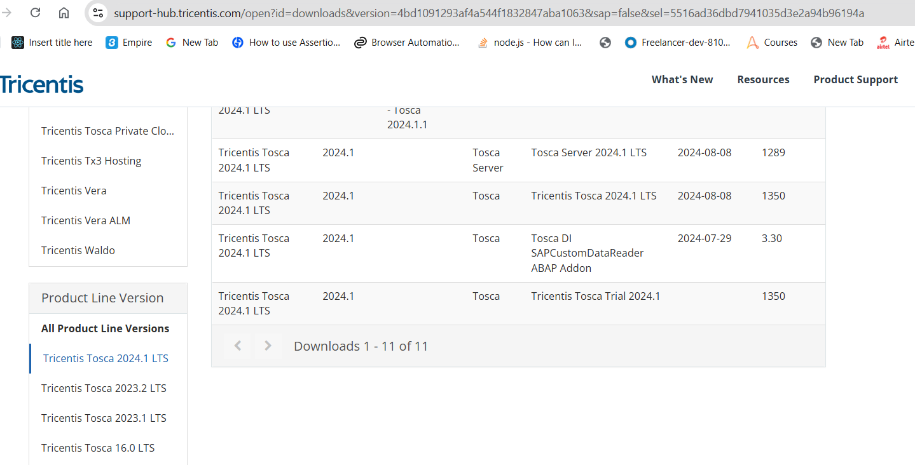

Tosca Server

Slide 90
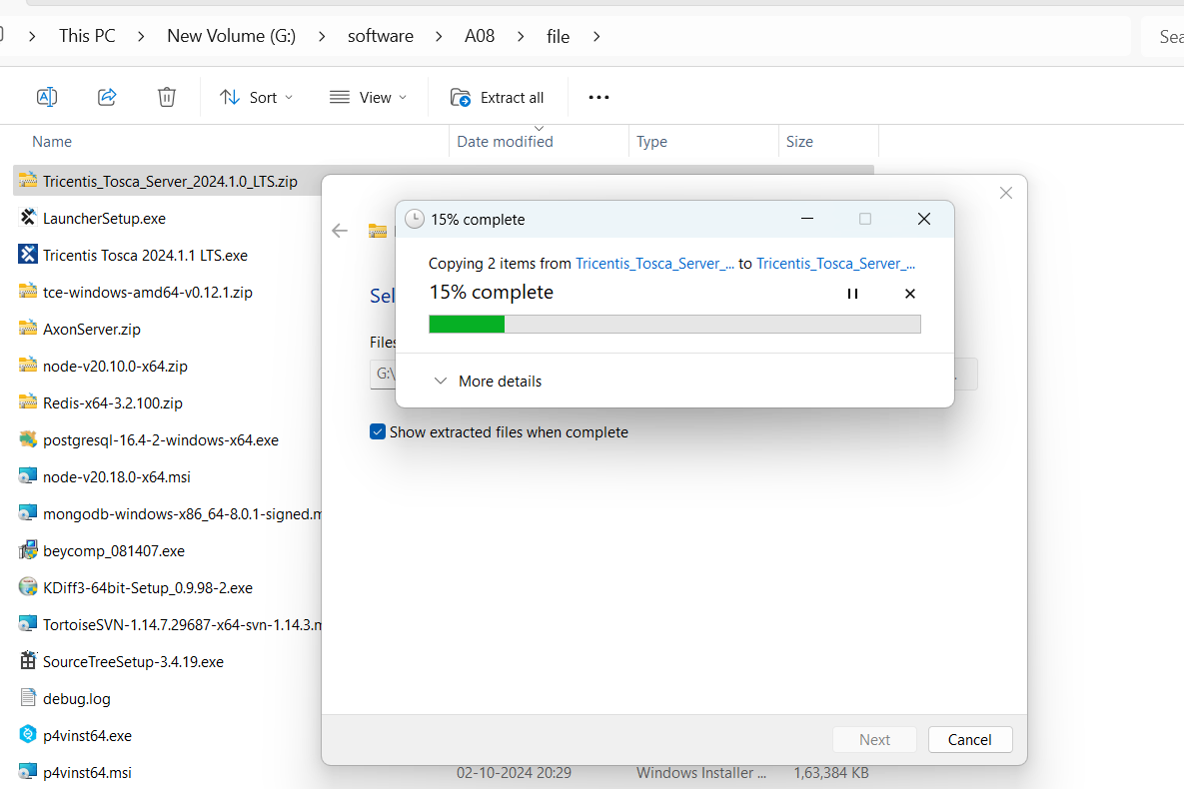
Tosca Server

Slide 91
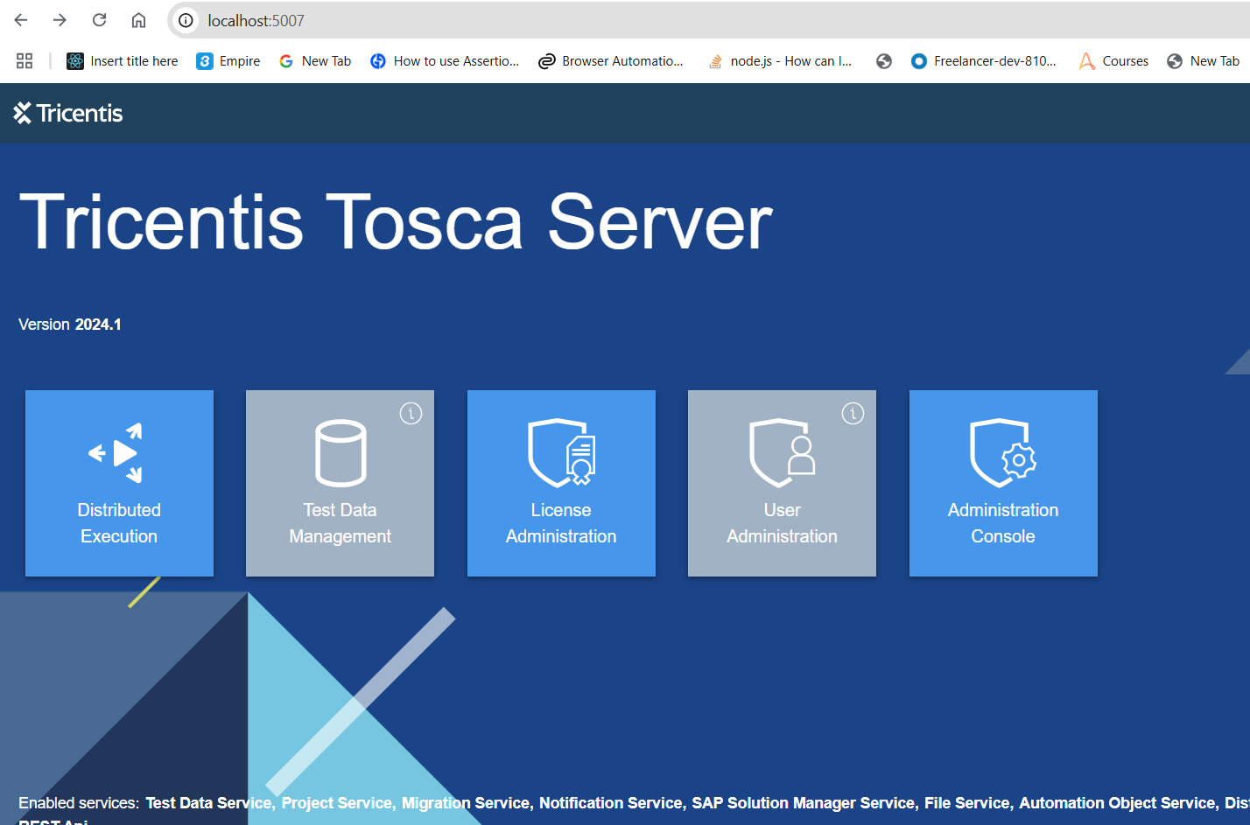
Tosca Server

Slide 92
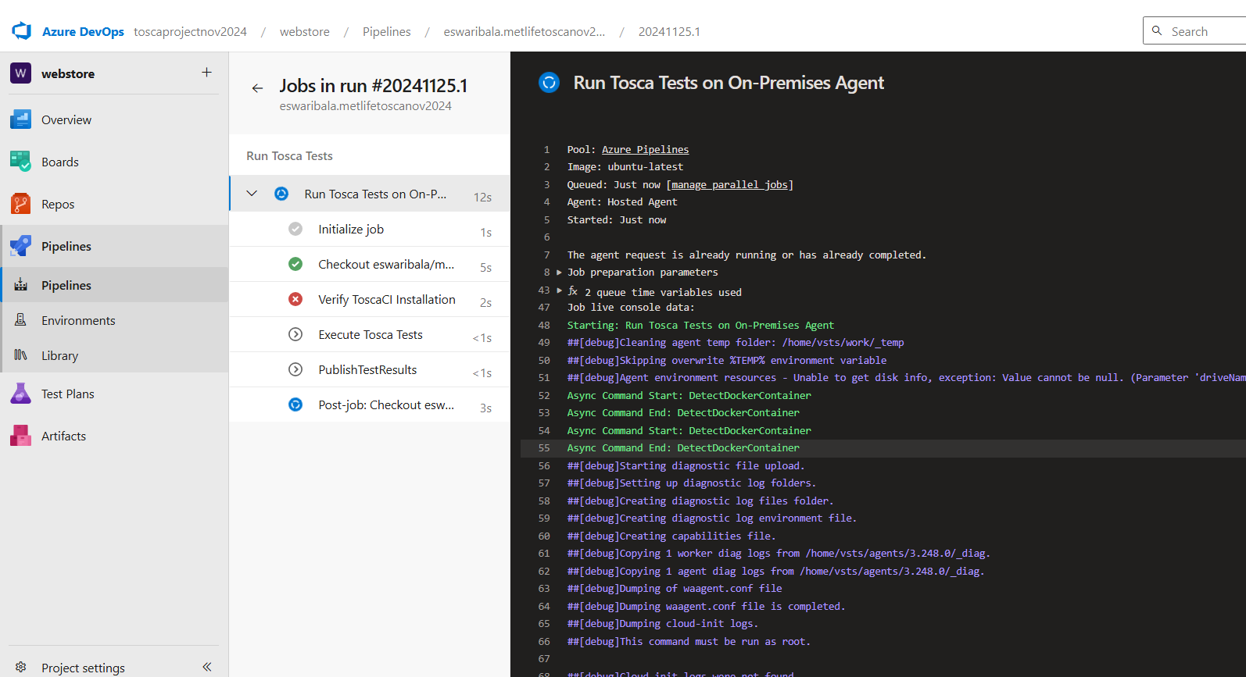
Tosca Server

Slide 93
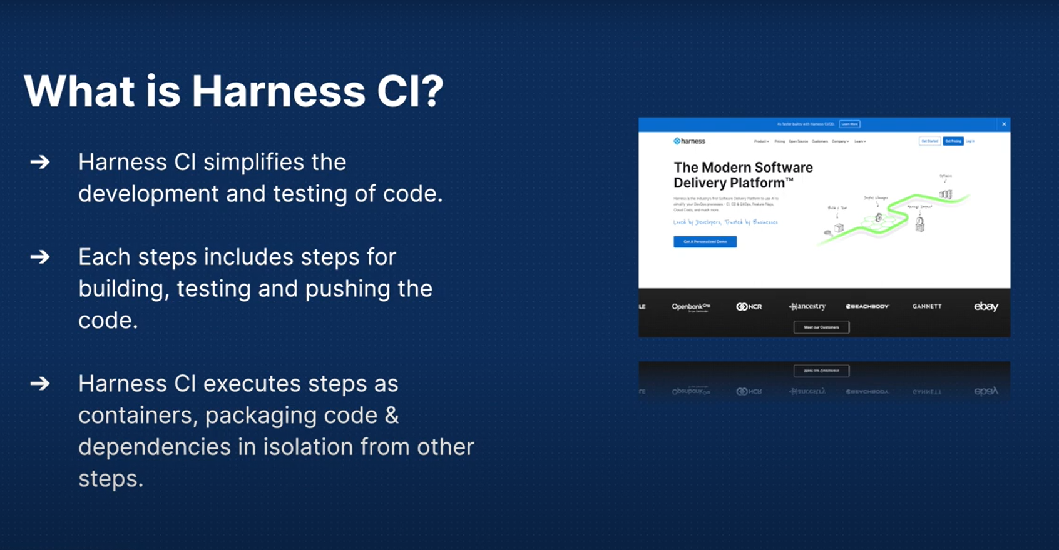
Harness

Slide 94

Harness

Slide 95

Harness

Slide 96

Agent Installer

Slide 97

Agent Installer

Slide 98

Agent Installer

Slide 99

Agent Installer

Slide 100

Harness

Slide 101

Harness

Slide 102

Harness

Slide 103

Harness

Slide 104

Harness

Slide 105

Harness

Slide 106

Harness

Slide 107
Questions

Slide 108
Module Summary
UXD Design Principles
The UXD Ecosystem
Proposal preparation
Project approach
Business objectives
User Research
Content Strategy
Transitioning - Definition to Design

Slide 109
Module Summary
Sitemaps and flow tasks
Wireframing and Annotating
Sketching
Prototyping models
Design user testing
From design to development
Flexible Content Strategies
Personas

